Slide 1





PRE-DEPARTURE ORIENTATION FOR ERASMUS+
STUDENT MOBILITY FOR STUDIES
2020-2021 SPRING SEMESTER
OUTGOING STUDENTS
AYBU INTERNATIONAL RELATIONS OFFICE
ERASMUS+ COORDINATORSHIP

Slide 2



CONTENT
Introduction to Erasmus+ Student Mobility for Studies Programme
Related Authorities
International Relations Office
Erasmus+ Documents and Steps
* Before Mobility
* During Mobility
* After Mobility
Sample Documents
Frequently Asked Questions & Suggestions

Slide 3

What is Erasmus+ Student Mobility Programme?
It is a European Union exchange programme for education, training, youth and sport that aims to modernize and globalize education and training, promote social equity, youth job accessibility, cooperation and innovation among young people across Europe.
The name of the programme comes from the significant Renaissance humanist scholar and philosopher Desiderius Erasmus (1469–1536).
The Programme is executed by the Turkish National Agency in Turkey.

Slide 4

Erasmus+ Terminology
European Commission
National Agency
Erasmus Charter
Interinstitutional Agreement
Erasmus Code
Sending Institution – Receiving Institution
Home University – Host University
Outgoing Student – Incoming Student
Erasmus Institutional Coordinator
Erasmus Departmental Coordinator
Nomination
Acceptance/Application
Learning Agreement (LA)
Grant
Contract
Erasmus Student Network (ESN)

Slide 5

Erasmus+ Student Mobility for Studies (SMS)
Erasmus+ SMS gives students opportunity for studying at universities across Europe, which have exchange agreements with AYBU, for one semester or for a whole academic year (3-12 months).
Students pay tuition fees (if they have to) only to our university. They will not pay extra tuition fees to the receiving institution.
Students are financially supported during their mobility by the European Commission with grants that differ according to the visiting country.

Slide 6
Erasmus+ SMS Programme
Erasmus+ SMS is not a
language learning programme
scholarship programme
diploma programme
a research programme
Participating in the Erasmus+ program does not mean that the student is transferring to another university.
Students must return to their home institution (AYBU) at the end of the Erasmus+ period and complete their study program here.

Slide 7

Turkish National Agency
Coordinates the information flow between the European Commission and the charter-holder Turkish Universities.
Being part of Foreign Affairs Ministry, Turkish N.A. is the coordinating and auditing body for all Erasmus+ activities and grants.
Turkish N.A. publishes the implementation guidebook for Erasmus+ which must be followed by all universities.
Address Information
www.ua.gov.tr
Mevlana Bulvarı No:181
Balgat-Ankara

Slide 8

AYBU INTERNATIONAL RELATIONS OFFICE
We are responsible for;
initiating and implementing collaborative inter-institutional agreements;
organizing programs for international delegations visiting AYBU at university administration level;
coordinating AYBU’s all international activities including Erasmus+ and Mevlana Exchange Programs;
providing assistance to outgoing and incoming students and academic/administrative staff;
maintaining and strengthening relations with partner universities, the Turkish National Agency and the Higher Education Council;
and many others.

Slide 9

AYBU INTERNATIONAL OFFICE
OFFICE MEMBERS | NAME & SURNAME
Head of International Relations Office & Erasmus+ Institutional Coordinator | Asst. Prof. Dr. Şemsettin TABUR
EU Projects Responsible Person Eurodesk Turkey & ESC Contact Person Student Mobility Advisor | Lec. B. Burak SOYER bsoyer@ybu.edu.tr
Student Mobility Advisor | Lec. Neshen İSAEVA GÜNEŞ nisaevagunes@ybu.edu.tr
Student Mobility Advisor | Gizem AKBAŞ gakbas@ybu.edu.tr

Slide 10
AYBU INTERNATIONAL OFFICE
Address:
Ankara Yıldırım Beyazıt Üniversitesi
Dış İlişkiler Koordinatörlüğü
Etlik Milli İrade Building, B Block, Floor 8, Room: 809-813
Ayvalı Mah. Gazze Cad. No: 7
Etlik-Keçiören / ANKARA
Tel: +90 312 906 1331
Fax: +90 312 906 2977
E-mail: erasmus@ybu.edu.tr
Web: http://ybu.edu.tr/dib/
Office Hours
Morning: 10.00 – 11.30
Afternoon: 14.00 – 16.30

Slide 11


What should I do now?

Slide 12
ERASMUS PERIOD
KEY INFORMATION
Sending Institution: Ankara Yıldırım Beyazıt University (AYBU)
Erasmus Code/ID: TR ANKARA 15
Erasmus Institutional Coordinator: Asst. Prof. Dr. Şemsettin TABUR
Subject Field Codes and Erasmus ID Codes of Universities
http://ec.europa.eu/education/tools/isced-f_en.htm
  Before the Mobility
During the Mobility
  After the Mobility

Slide 13

BEFORE THE MOBILITY
1. Student Nomination
2. Required Documents
Application Form (if required by the host university)
Learning Agreement (LA, compulsory)
Accommodation Form (if required by the host university)
Photograph (if required by the host university)
Passport
CV (if required by the host university)
Letter of Intent (if required by the host university)
Language Proficiency (if required by the host university)
3. Letter of Acceptance
4. Travel and Health Insurance
5. Visa
6. Bank Account
7. Leave of Absence
8. Contract……………then time for Erasmus+ ☺

Slide 14
BEFORE THE MOBILITY
AYBU IRO sends your nomination information form to the partner university.
You need to obtain your passport and then submit AYBU IRO the photocopy of the personal information page of your passport. Get your student certificate from Student Affairs Office and check https://www.nvi.gov.tr/hakkimizda/projeler/pasaport-bilgi.
After the nomination, the host university might send you or AYBU IRO an e-mail for the application details.
Application to host institution by the student: Online - deadlines are important! Each university has different application procedures and requires different documents; however, the Learning Agreement is required by all.
Acceptance letter by host institution: after the complition of the applications, if your applications are successful, the partner universities will send you/us your letters of acceptance.
When your letter of acceptance comes, inform AYBU IRO. AYBU IRO will give you an official visa/grant letter to be used for visa application.
Apply for a student visa once you have your acceptance letter. Get information about the required visa documents from the embassies and conculates of the countries you are to have your Erasmus+.
Inform AYBU IRO when you get your visa.
Pre-departure arrangements: health insurance policy, bank account, flight, accommodation, etc.

Slide 15
BEFORE THE MOBILITY
Student Nomination: AYBU IRO will nominate you to the first university you have chosen in the university preference list.
Application Form: The host university either will send it to you, or you will be expected to find it on their website.
Learning Agreement (LA):
LA is a negotiated agreement between the student, the sending and receiving institutions. It shows the courses you will take at the host university and their equivalents at AYBU. It has 3 parts: before the mobility, during the mobility, after the mobility. You will fill in only 'before the mobility part' before your mobility. It must be signed prior to your mobility period.
Check the courses you can take at the host university.
Consult your departmental coordinators so that you can choose the suitable courses.
Define the equivalents of the courses at AYBU.
You should take 30 ECTS in total. It can be minimum 25 ECTS and maximum 35 ECTS. The number of the courses is not important. What matters are the credits.
Fill in the form on the computer and get 3 copies printed.
Sign the LA by yourself and then make it signed by your departmental coordinator. Then bring it to AYBU IRO (scans are also acceptable during the pandemic).

Slide 16

BEFORE THE MOBILITY
Accommodation Form: If the host university offers accommodation, they might ask you to fill in an application form. They might send it to you or you can find it on their website. If the university does not have its own dormitories, they might guide you to find accommodation. You can also contact the Erasmus Student Network (ESN) of the university and/or the country.
Photograph: The host university might ask for an original or digital passport size photo.
Passport: Exchange students can get one-year valid passport without fee. Thus, obtain your student certificate from Student Affairs Office before you apply for passport. Give AYBU IRO the photocopy of the personal information page of your passport.
Curriculum Vitae (CV): The host university might require it too.
Letter of Intention: The host university might require it.
Language Proficiency: The host university might require a language certificate. You may use your AYBU Proficiency exam result if you do not have any other document.

Slide 17
BEFORE THE MOBILITY
Letter of Acceptance:
The host universities check your application documents.
If they approve your application, they send us and/or you a letter of acceptance/invitation by post or e-mail. You should inform us when you get the acceptance and give us one copy.
Official Visa/Grant Letter:
It is prepared by AYBU IRO upon the arrival of your acceptance letter. It may take a week to prepare it. Thus, arrange your visa application accordingly.
Travel & Health Insurance:
Might be required for visa application. If not, obtain it after you learn the result of your visa application. It must cover the whole period of your stay abroad. It must be valid in the country you will go. Therefore, you can consult the host university and/or the consulate and or the ESN of that university or country.

Slide 18

BEFORE THE MOBILITY
Travel & Health Insurance:
Travel&Health insurance is a must for the Erasmus+ grant agreement.
Health insurance policy requirements are different in each country. In order to avoid surprises, please follow the instructions & suggestions by host institutions/immigration offices. You must follow the instructions and get in touch with the suggested companies.
Travel Health insurance may suffice to get a visa but it may not cover your needs throughout your stay if an emergency situation occurs. So you must purchase a valid insurance policy that covers your whole study period and specifically states that your purpose of stay is studying abroad as an exchange student.
It should involve inpatient and outpatient treatment. And any kind of transfer.
You should submit your insurance policy to AYBU IRO.

Slide 19
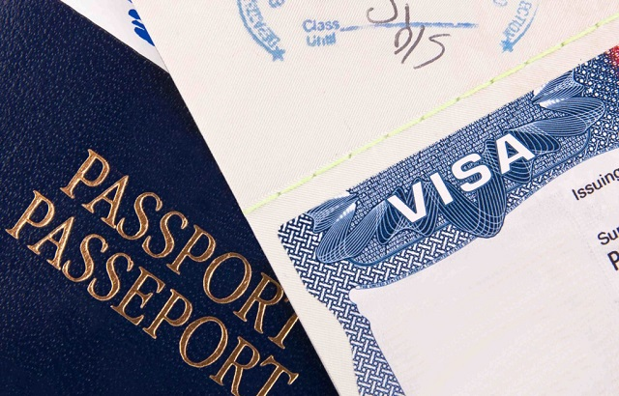
BEFORE THE MOBILITY
VISA PROCEDURES
Visa requirements and procedures differ from country to country. In order to save time, please follow the instructions & suggestions by host institutions/immigration offices and consulates.
AYBU IRO and the National Agency are not responsible for your visa application.
1. Check your host university’s international office website;
2. Check consulate/embassy webpages for documents;
3. Acceptance Letter from host institution;
4. Official visa/grant letter by AYBU IRO (visa support letter);
5. Health insurance policy, financial support letter, etc.;
6. Make an appointment for visa application;
7. Residence permit is usually taken once you arrive at the host country but it is better to check it before yout departure.
NOTE: Obtaining visa for some countries such as Czech Republic, Slovenia and etc takes longer than others. Thus plan accordingly.

Slide 20

BEFORE MOBILITY
Visa Photocopy: When you obtain your visa, bring it to AYBU IRO.
Bank Account: Obtain a Euro account at T.C. Halkbank Merkez Şubesi (Ulus Anafartalar Caddesi) and submit its copy to AYBU IRO.
ATTENTION: It is suggested that you open a shared bank account with someone you trust among family members and/or friends. Thus, that person can get your grant if necessary.
Faculty Term Permission: After you get your visa, you must apply your faculty/institute with a petition letter in order to be allowed to study abroad during that term. AYBU IRO will send you a sample letter. Submit a copy of LA, acceptance letter and visa together with your letter. Ask them to send one copy of the result to AYBU IRO.
Contract: It will be prepared at AYBU IRO in 2 copies. It shows your rights and responsibilities.

Slide 21

BEFORE THE MOBILITY
You must come and submit the following documents to AYBU IRO to sign the grant contract.
You will contact for the contract and grant issues at gakbas@ybu.edu.tr and/or +90 312 906 1331
Visa
Travel & Health Information
Bank Account
Faculty Term Permission

Slide 22
DURING THE MOBILITY
Please arrive at the host university on time, try to attend the orientation programme and do not leave before the term ends.
If you have to make any changes in your LA (add and/or drop any course/s),
1. Contact your AYBU Departmental Coordinator, choose new courses and their equivalents.
2. Fill in the DURING THE MOBILITY part of the LA.
3. First sign the part below the LA DURING THE MOBILITY PART by yourself. Then get it
signed by the coordinator at the host university and the departmental coordinator at AYBU.
You can send it to AYBU the coordinator and/or ask a friend for help. When all the signatures are complete, send the pdf version to erasmus@ybu.edu.tr
You should complete these procedures within 6-7 weeks after your arrival.
Notes:
Attending orientation session at host institution is mandatory
•Changes on the Learning Agreement within 4-7 weeks: Overlapping schedule? Send an email to your OzU Program Coordinator and get the necessary approval.
•Find out about the residence permit rules & regulations
•Learn your legal responsibilities
•Follow the online language courses if you received a password and username combination

Slide 23

DURING THE MOBILITY
Online Linguistic Support
The Online Linguistic Support (OLS system) provides participants in Erasmus+ the opportunity to assess their knowledge of the language they will use to study, work or volunteer abroad.
OLS gives participants the possibility to follow an online language course to improve their competences.
After you arrive the host university and/or AYBU IRO will subscribe you to the OLS system. You’ll receive your account and log in details by email so that you can take an online proficiency test.
You must take the exam within a 15-20 days.
Taking the assessment exams on time and following the online language course is an obligation.
Two assessments: before and after the mobility to check your progress.
It is suggested that you take the exam seriously. If you get B1 or below, the system registers you to the course automatically.

Slide 24

AFTER THE MOBILITY
Submit the following Documents to AYBU IRO
Certificate of Attendance/Confirmation of Stay-Study
Transcript
Photocopy of your passport
Final Report
OLS Result
LA After the Mobility Form
Submit the following documents to your faculty/institute for course recognition
Petition Letter
Learning Agreement (all of before, during and after mobility parts)
Certificate of Attendance/Confirmation of Stay-Study
Transcript

Slide 25

AFTER THE MOBILITY
Submit the following documents within a month upon your return. Prepare them before you leave the host university.
1. Certificate of Attendance/Confirmation of Stay-Study: Ask the host university to sign this certificate. It must include the dates of your stay at the host university. It must be an original copy with signature and stamp of the host university. You can ask the host university to prepare more than one so that you can keep one original for yourself. If they do not have a format to be used, give them the sample AYBU IRO have sent you by e-mail.
2. Transcript: It should be an original copy with signature and stamp of the host university. You can ask the host university to prepare more than one so that you can keep one original for yourself.
3. Photocopy of your Passport: Personal info page and entry dates page.
4. Final Report : It will be sent to your e-mail. Do not print it.
5. OLS Result: Print only the result page.
6. LA After the Mobility Form: It should be filled in by the host university according to your transcript.
The %20 of your total grant will be paid considering the dates in your certificate of attendance and passport. The shortest duration will be considered.
Notes:
After Exchange
1.Certificate of Attendance (download from SIS)
2.OLS 2nd language assessment exam
3.Passport copies (entry-exit stamps)
4.Learning Agreement (signed and stamped)
5.Participants’ Report (a link to take the online survey will be sent by the European Commission via email to you if necessary Erasmus+ documentation is completed.)
Upload your docs to SIS as soon as possible & don’t wait till the final deadline!
The final deadline is 8 August 2017
(IO will not be held responsible for consequences of late submissin. Including but not limited to: Erasmus+ grant being cut, asked to be returned back, delays in the transfer of credits and grades.)

Slide 26

AFTER THE MOBILITY
Transfer of Credits and Grade Conversion
It is the student's responsibility to carry out course recognition procedures.
The credits/courses you take abroad will be recognized either as compulsory and/or elective courses at AYBU.
Consult your departmental coordinator with the following documents.
Petition Letter (AYBU IRO will send you a sample)
Learning Agreement (all of before, during and after mobility parts)
Certificate of Attendance/Confirmation of Stay-Study
Transcript
Notes:
Transfer of Credits and Grade Conversion
•To benefit fully from the Erasmus exchange and to obtain full recognition upon return, you need to prepare your stay in advance.
•At the host University you will study a full time curriculum in subjects relevant to your OzU degree. These must be validated by your Program Coordinator in your Learning Agreement / Study Plan. You are expected to take 30 ECTS/term.
•Receive approval from your program coordinator otherwise credits and grades will not be converted into OzU credits and grades upon return. You can’t make special requests to exclude courses/credits from being transferred.
•If there are changes to your classes when you get to host institution (during your exchange period), you must contact your Program Coordinator immediately and get approval by email regarding the changes.
•No credit will be transferred until we receive an official transcript from the host institution (it might take up to 8 weeks)
•Soft version of transcripts sent directly by the host institution’s International Office may suffice.

Slide 27

ERASMUS+ GRANTS
AYBU IRO notifies the Turkish National Agency with the number of exchange students and amount of grants.
The Turkish National Agency presents the demands of all Turkish universities to European Union Commission (EU Commission).
EU Commission allocates grants to countries and universities. The results might be lower than the requested ones.
AYBU IRO designates the number of outgoing students in accordance with the amount of the total grant. Each academic unit is given equal quotas.
The granted outgoing students are selected according to a ranking system based on the selection criteria stated in the application announcement.
Notes:
In line with the National Agency rules, to support more students, OzU will fund max. 4 months of the study abroad period. If your study period is between 3 - 4 months, you will be funded for the exact duration (in days) of your academic stay. If it is longer than 4 months, you must acknowledge that you will not be funded more than 120 days.
•Please do not base your decision on the mobility grants and don’t forget that grants will fund you partially, and you will need additional resources for essential living expenses such as food and rent.
•For those who will receive the grant, the money transfer will be made in two installments. These students will need to provide a Euro draw account in a Turkish bank.
•OzU will only transfer your grant upon receiving the allocated budget from TR N.A. (If there is a delay, it may affect the fall term outgoing students.)
•% 70 of the grant amount will be paid when you get your visa (before the mobility) and %30 will be paid if/ when the Erasmus exchange student fulfills the academic responsibility. (after the mobility)
•Deadline to submit your full set of document 8 August 2017 – those who don’t, will not be able to receive the remaining amount of the Erasmus+ grant.
•Please be patient and check your account frequently.
•It’s possible to benefit from Erasmus+ as a «zero grant» student. Grants are not guarenteed and don’t cover the whole expenses of your study abroad period.
TR Ulusal Ajansı Erasmus+ Uygulama El Kitabı
Öğrencilerin faaliyet süreleri ve hibeleri, faaliyet başlamadan önce tahminî olarak hesaplanır. Faaliyet sona erdikten sonra gerçekleşen kesin süreler ve hibeler tekrar belirlenmelidir.
Faaliyete başlamadan önce yapılacak planlamada gidilecek kurumdaki akademik takvim, öğrencilerin kabul mektuplarında yer alan süreler, önceki yıllarda ilgili kurumda gerçekleşen faaliyetlerden edinilen deneyimler gibi mevcut bilgi ve belgelere göre faaliyet süresi öngörü olarak belirlenir. Kesin faaliyet süresi, katılım sertifikasında bulunan faaliyet başlangıç-bitiş tarihleri ve pasaportta yer alan giriş-çıkış tarihlerine göre hesaplanır. Belgelerde yer alan en kısa tarih aralığı faaliyet süresi olacak şekilde kabul edilir.
Öğrencilerin faaliyet süreleri kısmen veya tamamen hibelendirilir veya faaliyet tamamen hibesiz “sıfır hibeli” öğrenci olarak gerçekleştirilebilir. Faaliyet süresinin kısmen hibelendirilmesi halinde, hibe verilecek süre, öğrenim hareketliliği için ise 3 ay’dan, staj hareketliliği için 2 ay’dan kısa olamaz. Öğrenciye verilecek hibe “Hesaplama Aracı” kullanılarak hesaplanır.
•Hareketlilik aracında başlangıç-bitiş tarihleri girilerek ve varsa kesinti süreleri çıkartılarak hesaplanan faaliyet süresinin en az asgarî süreyi karşılaması gerekmektedir.
-Öğrencilerin ödemeleri, standart öğrenci sözleşmesinde yer aldığı üzere, %70 oranında 2 taksitte yapılır. Ödemeler Avro cinsinden yapılır.
Faaliyet dönemi sonunda öğrencinin çevrimiçi AB anketini doldurması mali desteğin geriye kalan kısmının ödenmesini talep etmesi olarak kabul edilir.
-Her durumda, öğrenciye en fazla gerçekleştirdiği faaliyet süresi kadar hibe verilir. Öğrencinin öngörülen hibelendirme süresinden daha kısa süre ile faaliyet gerçekleştirmesi halinde, kesin faaliyet süresi için hesaplanandan daha fazla ilk ödeme yapılmışsa, fazla miktarın öğrenciden iadesi istenir. Hibe hesaplamalarında katılım sertifikasındaki ve pasaport giriş/çıkış tarihlerindeki kalınan süreye hareketliliğin başlangıç ve bitiş günleri de dahil edilir. Süre hesaplanırken bu iki belgedeki en kısa tarih aralıkları dikkate alınır.
-Gidilen kurumdaki resmî tatil günleri hariç, öğrenimin devam etmesi gereken durumlarda 1 haftadan fazla süre ile misafir olduğu kurumdan (şehirden) ayrılması durumunda ayrı kaldığı süreler için hibe ödemesi yapılamaz. Daha önce ödeme yapılmış olsa bile bu dönem için verilen hibenin iadesi talep edilir.
-Üniversite, sorumluluklarını yerine getirmeyen ve/veya başarısız (20/30 AKTS’den başarılı olunmalıdır) öğrenci hibelerinde kesinti yapabilir. (2. hibe ödemesi yapılmaz.)
-İlk planlamada ödeneceği öngörülmesine rağmen ödenmeyen ve/veya ödendikten sonra öğrencilerden geri istenen tutarlar, Merkez’e iade edilmelidir.

Slide 28
ERASMUS+ GRANTS
The Erasmus grant is a support for your studies. It can cover only some part of your expenses.
Students are advised to get informed about the visa and living expenses of the countries that they will visit.
Erasmus grants will be paid in two instalments. % 80 of the total grant will be paid before the mobility and %20 after the mobility.
Before the mobility, the total grant is calculated over 4 months and % 80 of this 4 months’ grant is paid before students leave (as if students will stay abroad for 4 months in total).
After the mobility, you are expected to have carried out all the principles of Erasmus+, have stayed at least 3 months at the host university and have passed at least 20 credits in order to be paid the rest of the grant (%20).
After the mobility, students should submit the 'after mobility' documents. Then AYBU IRO identifies how many days they stayed abroad. AYBU IRO compares the dates on the passport and the certificate and calculates the total duration of stay of the students. The shortest period is considered. If the students stayed abroad longer than 4 months, extra payment is made for the days over 4 months during the payment of %20. If the students stayed abroad less than 4 months, deduction is made for the days less than 4 months during the payment of %20.

Slide 29
ERASMUS+ GRANTS
Country Types | Host Countries | Monthly Grant (Euro)
1. and 2. Group Program Countries | Austria, Belgium, Cyprus (South),Denmark, Finland, France, Germany, Greece, Iceland, Ireland, Italy, Liechtenstein, Luxemburg, Malta, Norway, Portugal, Spain, Sweden, The Netherlands, United Kingdom | 500
3. Group Program Countries | Bulgaria, Crotia, Czech Republic, Estonia, Hungary, Latvia, Lithuania, Macedonia, Poland, Romania, Serbia, Slovakia, Slovenia | 300

Slide 30
Sample
A student going to Poland will be paid 300 Euro per month.
4-month grant: 300x4 = 1200 Euros
First Payment: %80 = 960 Euros
Second Payment – Sample of First Case:
Duration of Stay: 18 February - 17 June 2019 = 120 days = 4 months
Thus, 240 Euro is paid as the %20 of 1200 euro.
Second Payment – Sample of Second Case:
Duration of Stay : 18 February - 01 June 2019 = 104 days = 3 months 14 days
Since it is less than 4 months, the total payment is not 1200 Euro but 1040 Euros. Since the student is paid 960 Euros before the mobility, %20 will not be 240 euro, it will be 80 Euros.
Second Payment – Sample of Third Case:
Duration of Stay : 18 February - 01 June 2019 = 133 days = 4 months 13 days
Since it is more than 4 months, the total payment is not 1200 Euros but 1330 Euros. Since the student is paid 960 Euros before the mobility, %20 will not be 240 Euros, it will be 370 Euros.

Slide 31
When are grants withdrawn or not paid?
If you stay at the host university less than 3 months without any compelling reason, you will be asked to pay back all the grant and you will not be considered an Erasmus student.
If you leave the host country for more than 7 days in total, you will be asked to pay back the grants of those days.
If you have 0 ECTS because of absence, % 20 of the grant will not be paid.
If you cannot pass at least 2/3 of the courses you take and cannot have 20 ECTS in your transcript, % 20 of the grant will not be paid.

Slide 32

Academic Culture
There might be different expectations with regard to written work, class types/sizes, modes of assessment;
Be prepared for different styles of teaching;
Familiarize yourself as much as possible before you departure;
Research academic guidance on the host institution website;
Read carefully any orientation materials from your host institution;
Don’t make assumptions based on your experience at AYBU – get help when you’re in doubt.

Slide 33
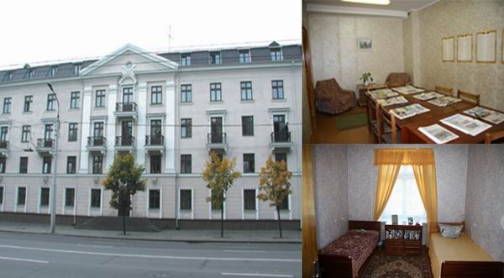
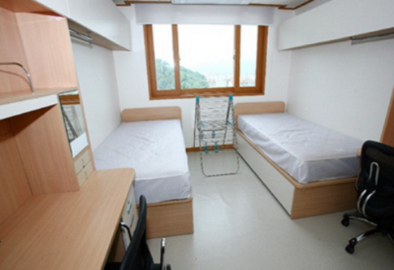
Accommodation
Many universities offer on campus accommodation, but some of them may not. Some may assist you in finding suitable private (off-campus) accommodation.
Making such arrangements are the responsibility of AYBU students.
Read student reports to get student recommendations for student and private accommodation.
If you do decide to look for private accommodation, consider the following:
Price? (Does it include bills? If not, what are the bills for?)
Location? (Is it near your classes? If not, what are transport costs?)
Area? (Is the area safe? Do other students choose to live there?)

Slide 34

Take a copy of your passport and keep it in a different location from your original.
Have the program emergency contacts in your phone and keep your phone charged. Keep a hardcopy of emergency numbers and important websites.
In some countries, photographing police, military or government buildings or monuments can get you into serious trouble get informed about the culture of the country you will visit.
Show respect for cultural, political, social sensitivity.
Inform AYBU IRO and the host university IRO in case of a problem.

Slide 35

SAMPLE DOCUMENTS
Learning Agreement (LA)
LA During the Mobility
LA After Mobility Formu
Application Form
Letter of Acceptance
Leave of Absence
Insurance
Official Visa/Grant Letter
Certificate of Attendance
Passport
Course Recognition Form

Slide 36
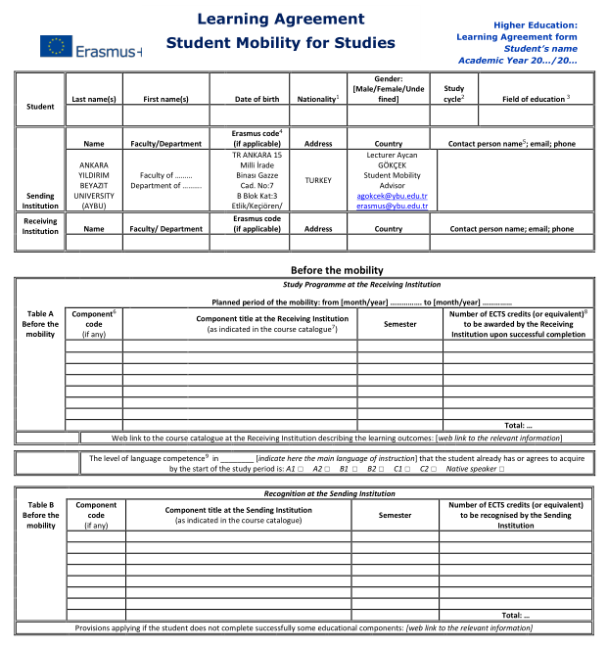
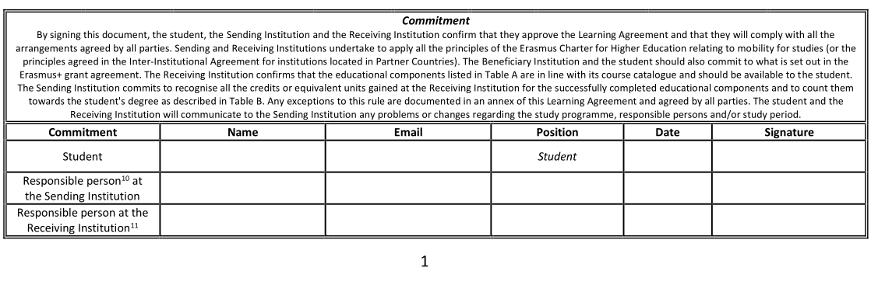
Learning Agreement
Tablo A: Write the courses you will take abroad
First sign yourself
Second, ask AYBU departmental coordinator to sign
Write your foreign language and level
Third, AYBU IRO staff signature
Tablo B: Write the AYBU equivalents of the courses you will take abroad

Slide 37
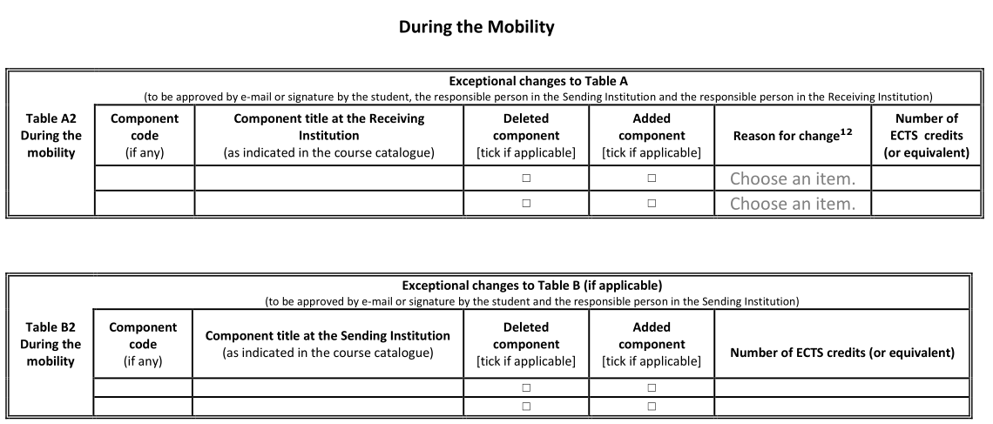
Learning Agreement-During the Mobility
First, Contact your AYBU Departmental coordinator.
Table A2: Write the courses you will delete or add. You can add lines
First sign yourself
Table B2: Write the AYBU equivalent of the courses you will delete or add. You can add lines
Second, ask for AYBU departmental coordinator's signature
Third, bring for AYBU IRO staff's signature

Slide 38
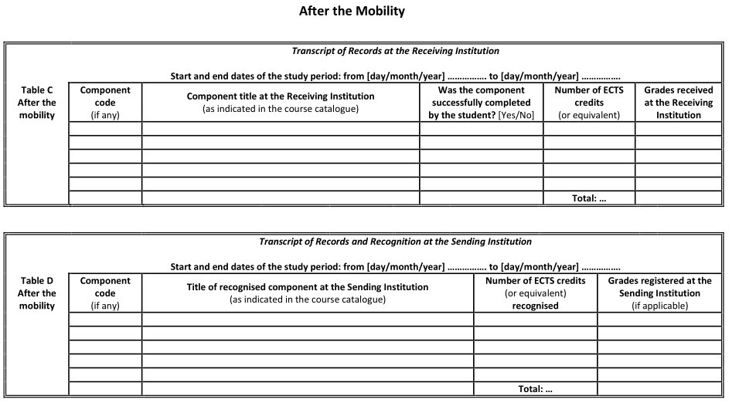
Learning Agreement & After the Mobility
Table C: Write the courses in your transcript
Table D: Write the AYBU equivalents of the courses in your transcript

Slide 39
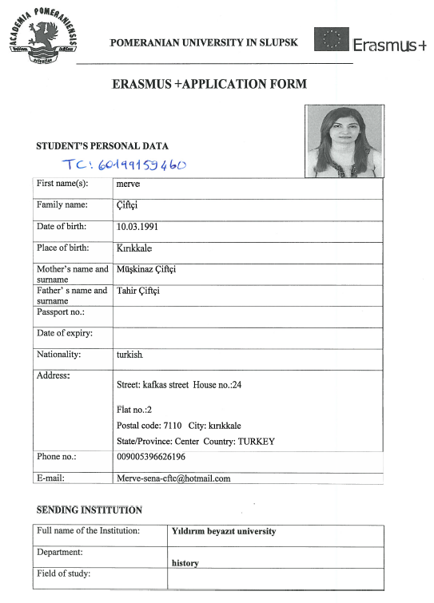
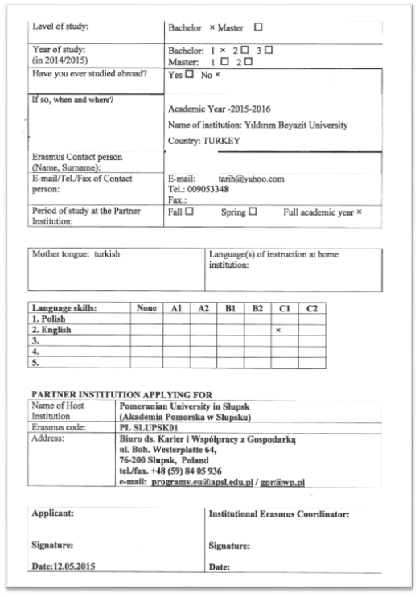
Application Form

Slide 40
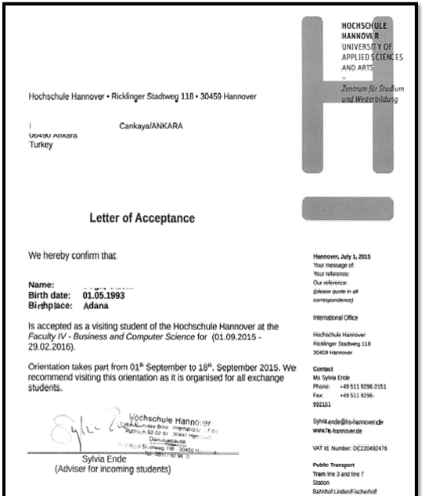
Letter of Acceptance

Slide 41
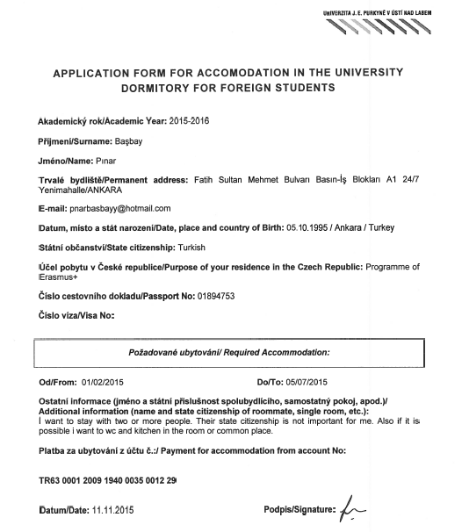
Accommodation Form

Slide 42
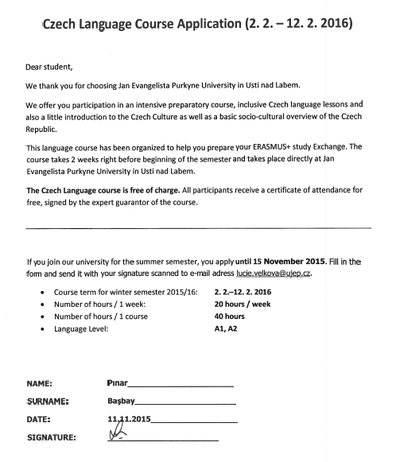
Language Course Apllication Form

Slide 43
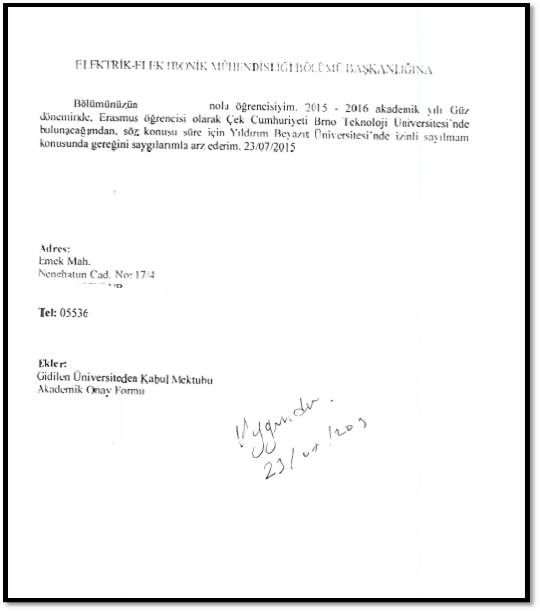
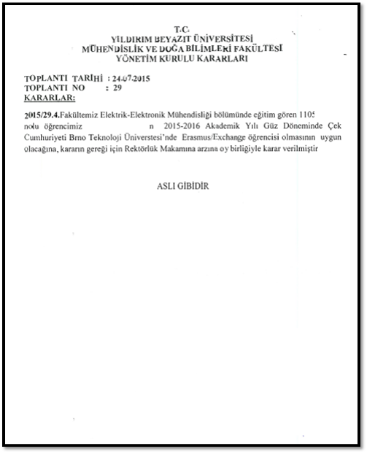
Term Leave Petition & Leave Permission Document

Slide 44
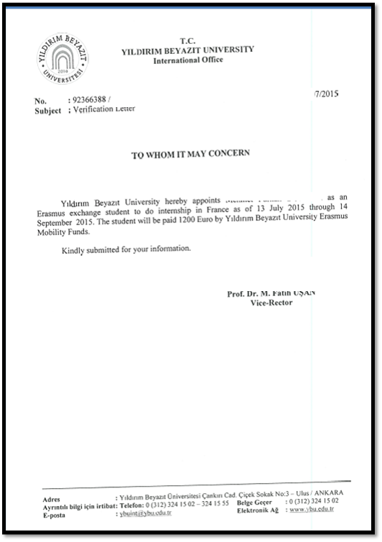
VISA/GRANT LETTER

Slide 45
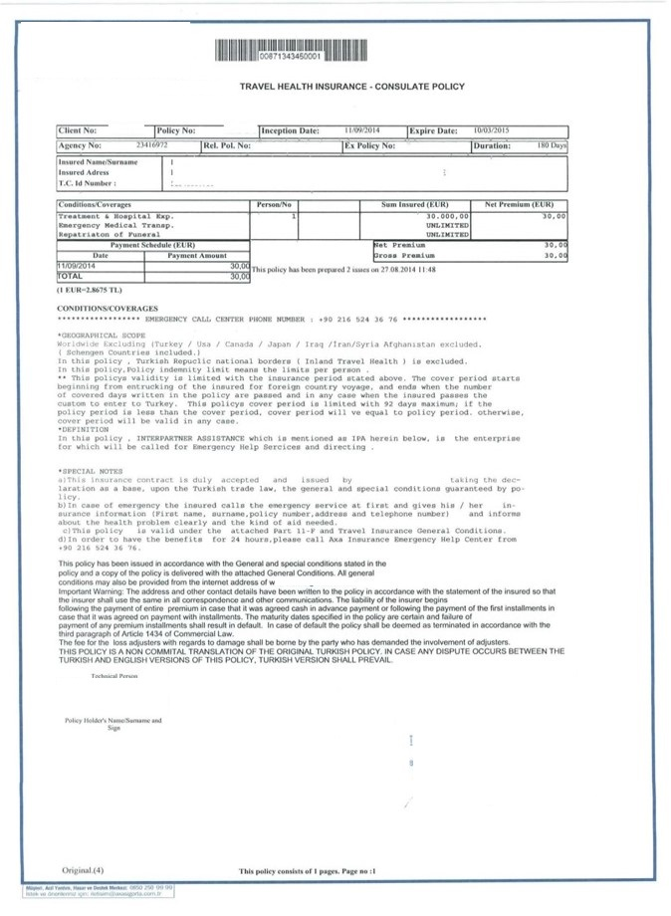
Travel&Health Insurance

Slide 46
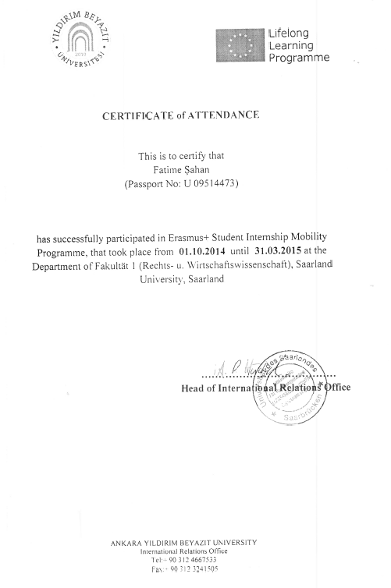
Certificate of Attendance

Slide 47
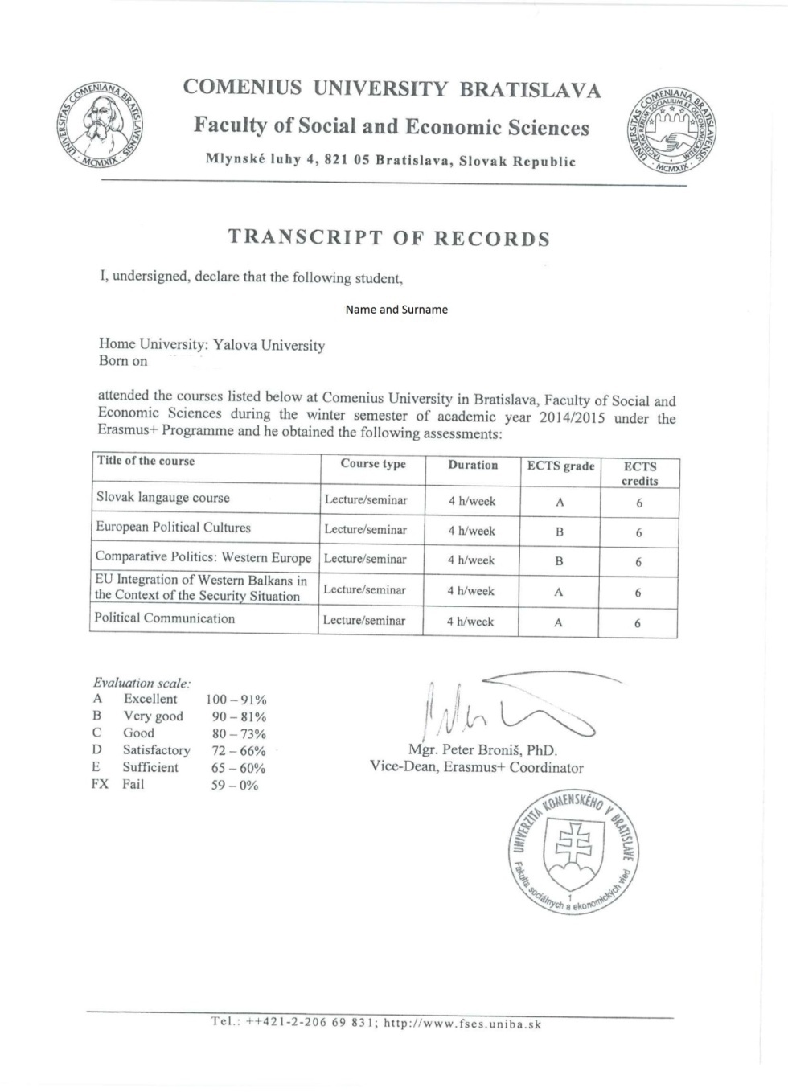
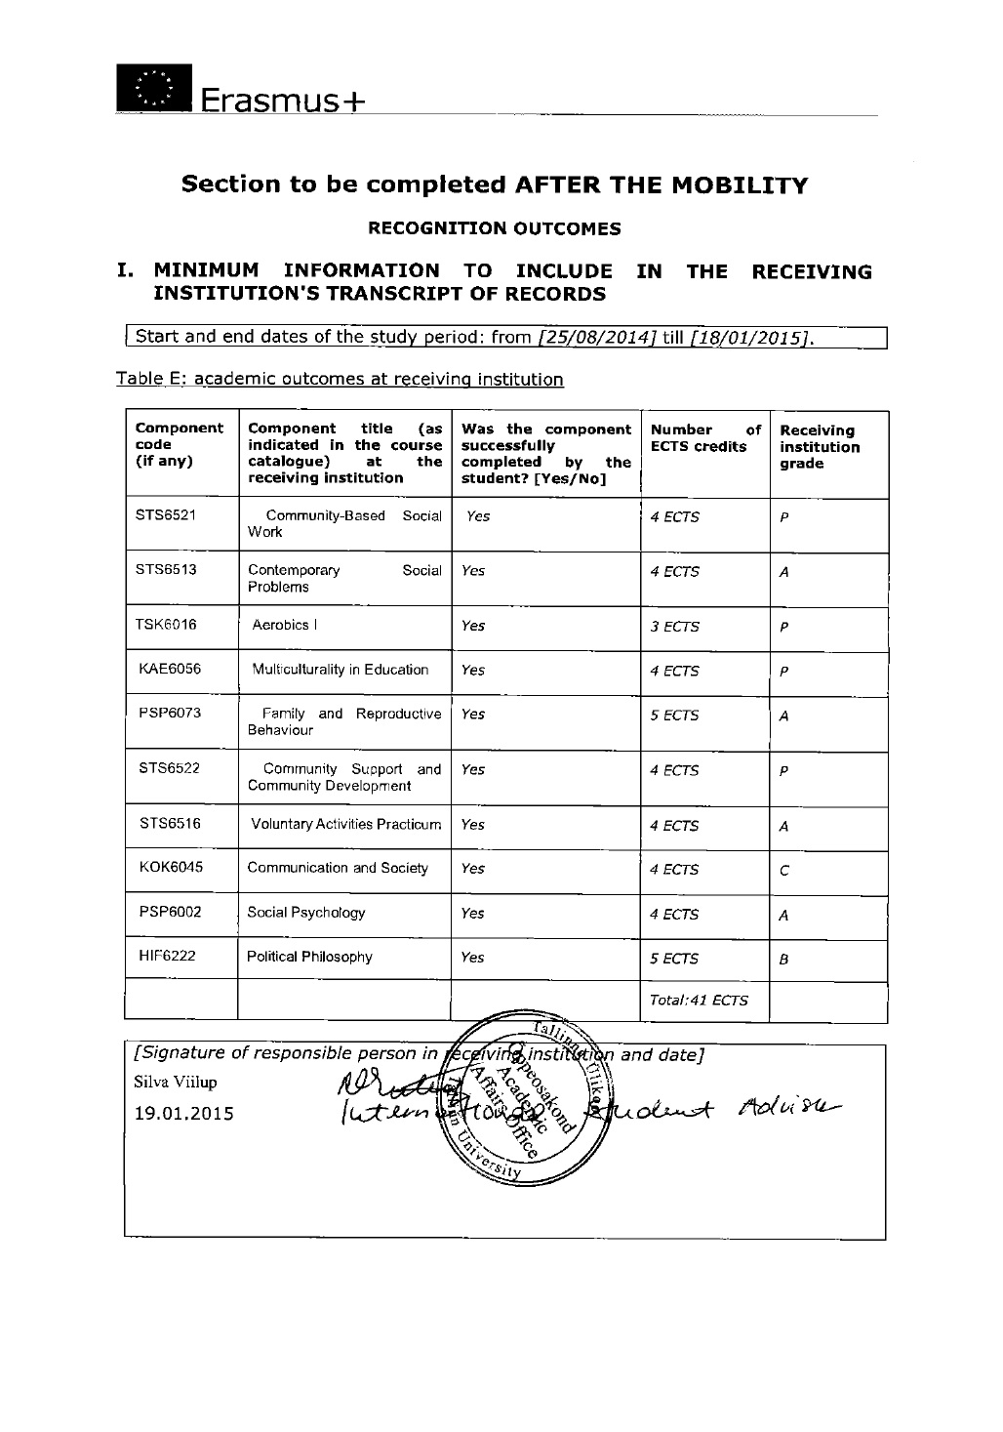
After Mobility & Transcript

Slide 48
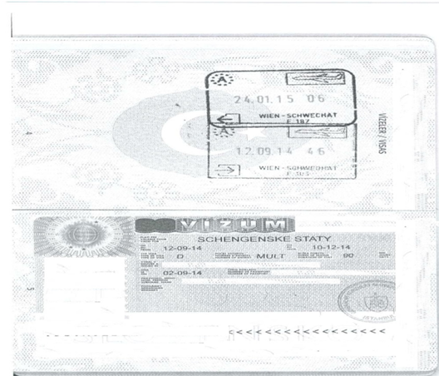
Passport Entry Page

Slide 49
Please Be Careful
Learning Agreement: You are not suggested to take a course you have taken before.
Dormitories: Inform your dormitory that you will be an Erasmus student
Passport: Be sure that it is valid. Check if you need visa.
Residence Permit: Learn about it from the host university and the embasy.
Tuition: Students will continue to pay (if they are required) compulsary tuitition fees to their home institution (AYBU) during the exchange. Otherwise, they will not be able to participate in the programme.

Slide 50

RESPONSIBILITIES
The student is responsible for her/his own exchange;
The student should take a close look at partner institution’s webpage/deadlines;
The student is advised to talk with former AYBU students and incoming students;
The student should know their deadlines and complete their application by these dates;
AYBU IRO does not have any housing responsibility OR control of the housing, travel, passport and visa offices. Partner institutions’ International Offices may not have control over them too; thus try to get informed as much as possible.
Students are highly advised to get involved with the ESN Club/International Student Body while studying abroad.
The student should obey the rules of the host country and institution.

Slide 51

SUGGESTIONS
Checking e-mails regularly.
Please first read the e-mail and guideliness AYBU IRO sends you
Be in contact with departmental coordinators and AYBU IRO and host university
Fill in the forms and documents correctly and submit them on time.
Read the Erasmus+ Program official guideliness
* Erasmus+ Programme Guide,
* Erasmus+ Uygulama El Kitabı
* Erasmus Student Declaration
* Grant Contract

Slide 52


Slide 53


In case you have further questions, please contact us at erasmus@ybu.edu.tr
We wish you good luck ☺!

Slide 54






DIŞ İLİŞKİLER KOORDİNATÖRLÜĞÜ
erasmus@ybu.edu.tr
/aybuint
/aybuinternational
AYBÜ Etlik Milli İrade Binası, B-Blok, Kat-8
Tel: +90 312 9061331
www.ybu.edu.tr/dib

Slide 55


