Slide 1


Ankara Yildirim Beyazit University
Software Engineering
Internship Principles

Slide 2
Content
Related Research Assistants
General Information
Pre-Internship Process
Internship Process
Post Internship Process
Evaluation
Frequently Asked Questions
Contact
Question & Answer

Slide 3

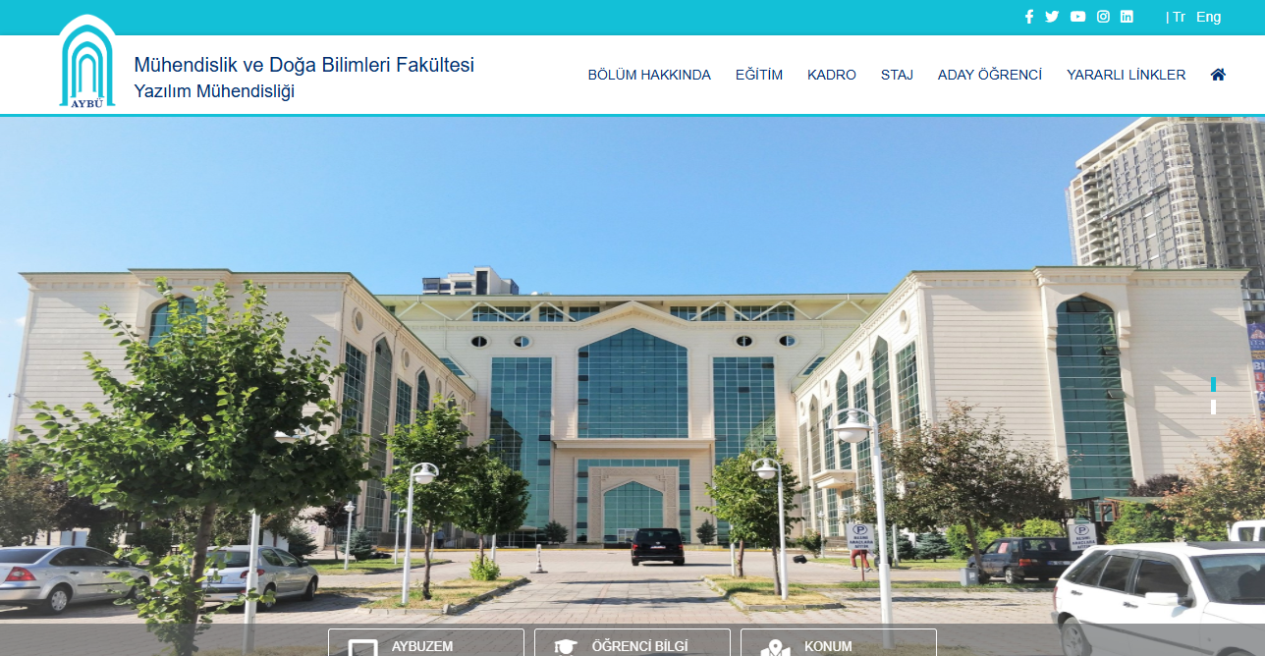

Software Engineering Internship Principles
In the Internship page of Software Engineering department webiste, you can find all related documents.

Slide 4

Internship Commission
Commission Chairman
Dr. Fatma KÜÇÜK
(fatmakucuk@aybu.edu.tr)
Commission Members
Research Assistant
Murat Can YILMAZ (muratcanyilmaz@aybu.edu.tr)
Research Assistant
Kübranur GÜMÜŞLÜ (kubranurgumuslu @aybu.edu.tr)

Slide 5

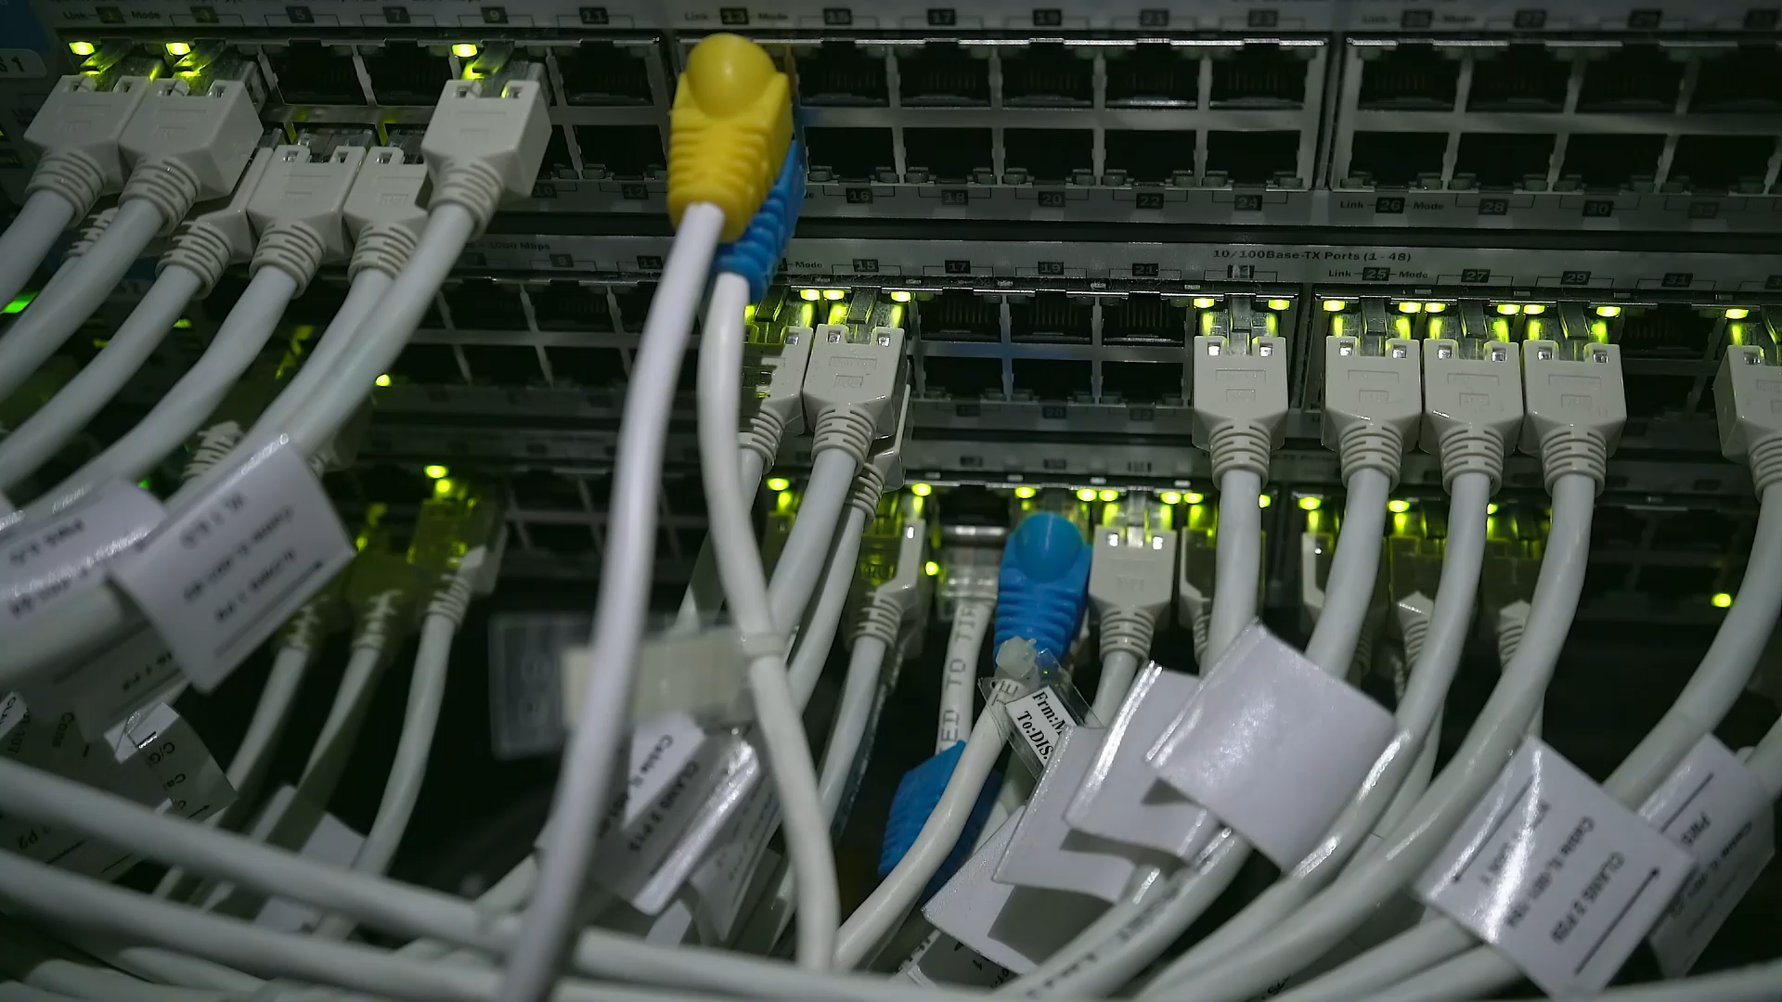
General Information

Slide 6

General Information
Our students must do 2 (20 + 20 working days) internships to graduate. (A student has the right to get insurance from the school for a total of 60 working days. Those who have unsuccessful internships or those who will do voluntary internships will not be able to get more insurance from the school when they exceed this limit).

Slide 7
General Information
Internships should not coincide with the Fall and Spring Semesters of the academic calendar.
The normal duration of the internships is during the Summer Semester of the 2nd year and the Summer Semester of the 3rd year.
In the Fall Semester following the summer internship, SENG300 is designated for the first internship, while SENG400 is allocated for the second internship.

Slide 8

WARNING
To be eligible for SENG300you must have earned at least 101 successful ECTS credits. For SENG400 the requirement is a minimum of 149 successful ECTS credits. The same requirement applies to Volunteer Internship as for SENG400.

Slide 9
General Information
Weekends cannot be included in the calculation of internship periods.
Internship 1 and Internship 2 can be completed within the same institution.
Only students in their 3rd year or above, who have not undertaken their internship during their 2nd year or have failed to do so, are eligible to conduct consecutive internships within the same institution. Documentation should be prepared for two separate periods of 20 working days each, treating them as distinct internships.
Students also have the option to pursue internships abroad through self-funding or the Erasmus+ program, particularly in companies related to Computer Science.

Slide 10

General Information
Public holidays are excluded from the calculation of internship periods. Students who are going to experience an official holiday or half-day during their internship period should adjust their dates to ensure completion of 20 working days without considering these days as working days (such as Eid al-Adha, July 15, August 30, etc.).
For instance:
  Internship Start: August 12
  End of Internship: Monday, September 9 (Ordinarily, it would end on Friday, September 6, but since August 30 falls within the period, one additional working day is added to the end of the internship).

Slide 11
General Information
The supervisor responsible for overseeing the internship must hold either a 4-year undergraduate degree in Computer Engineering, Software Engineering, Electrical-Electronics Engineering, or Artificial Intelligence Engineering, or a postgraduate degree in Computer Engineering/Science or Software Engineering/Science.
Students intending to apply for internships must submit the following Internship Application documents to the Department Secretary from the start of the Spring Semester Final exams (May 10, 2025) until the last day of the Spring Semester Final Make-Up exams (June 20, 2025).
Prior to the internship application, Software Engineering students are required to complete the Excel table (It will be provided in a future announcement). Access to the Excel table will be closed at 17:00 on June 20, 2025.
During the internship period, students are not permitted to take leave unless under unavoidable circumstances such as illness or a funeral. Leave taken due to compulsory situations cannot exceed 2 days. Students who take leave or report must complete these missed days by adding them to the end of the internship.

Slide 12

Insurance by the University
The Dean's Office of the Faculty of Engineering and Natural Sciences ensures that each student undertaking an internship within the scope of the Social Insurance and General Health Insurance Law No. 5510 is covered by "occupational accident and occupational disease" insurance.
This insurance coverage is mandatory, even if the student already has insurance through the company.

Slide 13

Pre-Internship Process

Slide 14




Pre-Internship Process
Students apply to institutions where they intend to undertake their internship and select their preferred placement.
  Various methods may be employed for internship applications, including submissions through platforms like "Kariyer.net," "Kariyer Kapısı," "Vizyoner Genç," "LinkedIn," as well as direct communication with corporate entities via email, among other approaches.
  Difficulty in securing an internship placement typically does not occur when a sufficient number of applications are made.

Slide 15
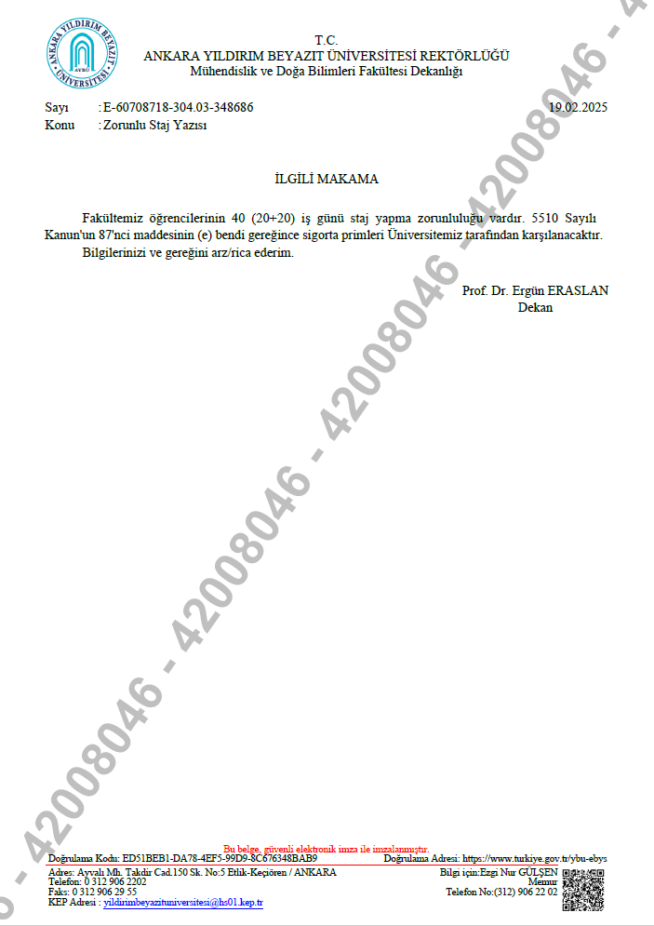
Pre-Internship Process
If it is required for the student to provide proof that the internship company's insurance will be arranged by the school, the Internship Application Form (Zorunlu Staj Yazısı) document, electronically signed by the dean, can be printed out and submitted to the company.

Slide 16
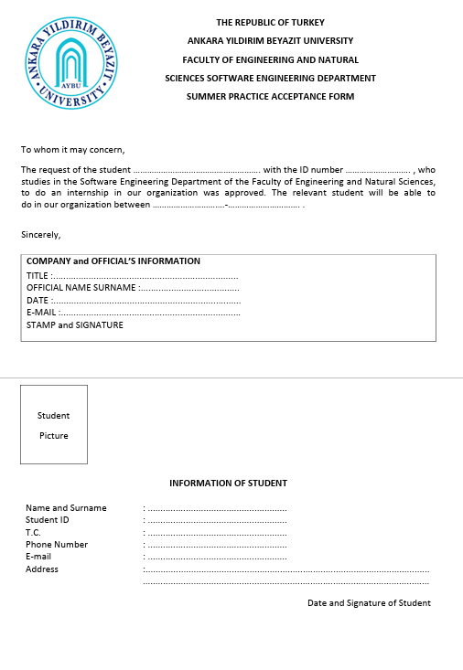
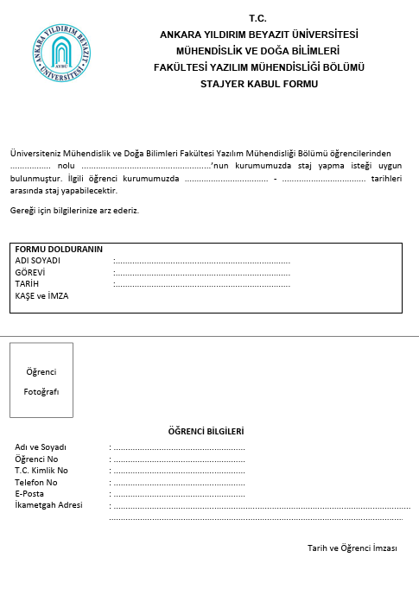
Pre-Internship Process
The student must have the Internship Acceptance Form (Staj Kabul Formu) signed by the company official, and before starting the internship, the student should confirm that there will be a Computer (or Software, Electrical-Electronics, Artificial Intelligence) Engineering graduate responsible for them in the company.

Slide 17
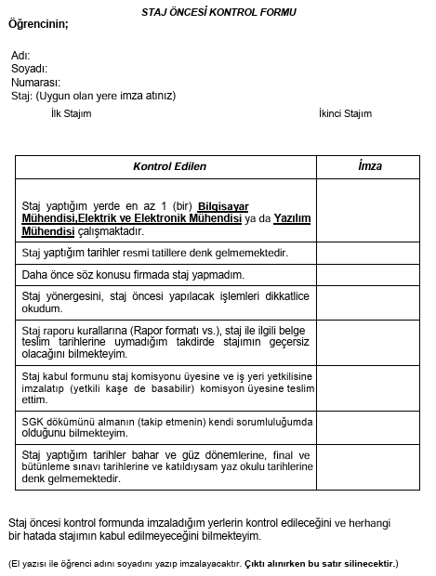
Pre-Internship Process
The student must sign the Pre-Internship Check Form (Staj Öncesi Kontrol Formu).

Slide 18
Documents Required for the Pre-Internship Process and Submission Deadlines
The Internship Acceptance Form (Staj Kabul Formu), the Pre-Internship Check Form (Staj Öncesi Kontrol Formu), Transcript(send it via mail to sengaybuinternship@gmail.com end of the term; Subject:Name-Surname and Student_ID, attached document: transkript.pdf), and General Health Insurance Declaration and Commitment Form (GSS Beyan ve Taahhütname) must be submitted to the Department Secretary between the start of the Final Exams and end of Final Make-Up Exams (May 10, 2025 – June 20, 2025, between 9:00 AM and 4:00 PM.).
You are required to fill in your personal information in the Excel file that will be shared in the future before submitting your documents, otherwise your files will not be accepted by the Department Secretary.

Slide 19
Pre-Internship Process
Students can start their internships at the firms they have chosen unless there is something unsuitable mentioned at the internship sites or in their applications.
Some companies may request the SGK Entry Certificate.
  Students who want to obtain this document can request their documents by emailing muhendislik@aybu.edu.tr one week before the start date of their internship. If they prefer to receive it in person, they can apply to the Faculty Secretary's Office.

Slide 20

Internship Process

Slide 21
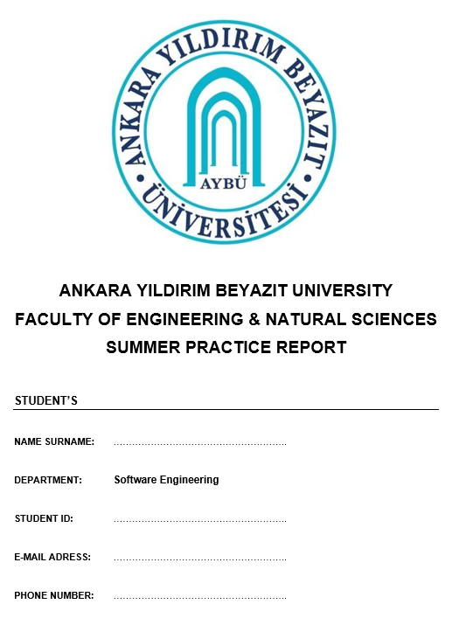
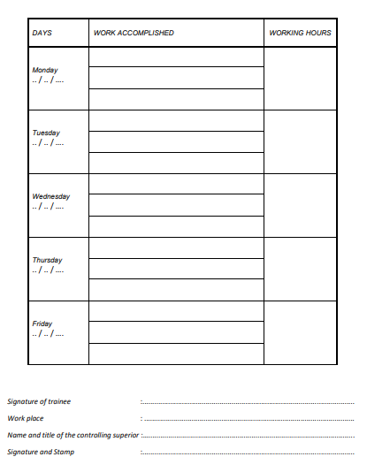
Internship Process
Students who have completed the above processes begin their internships.
The report must be filled out in English and in digital format.
During the internship, students fill out the Internship Summary section of the Internship Report day by day in digital format, limiting it to one paragraph.

Slide 22

Internship Process
During the internship period, some students may intern at companies focused on the defense industry. Students working at these companies should request applications and tasks that they can write in their internship logs from their mentors.

Slide 23

Post-Internship Process

Slide 24

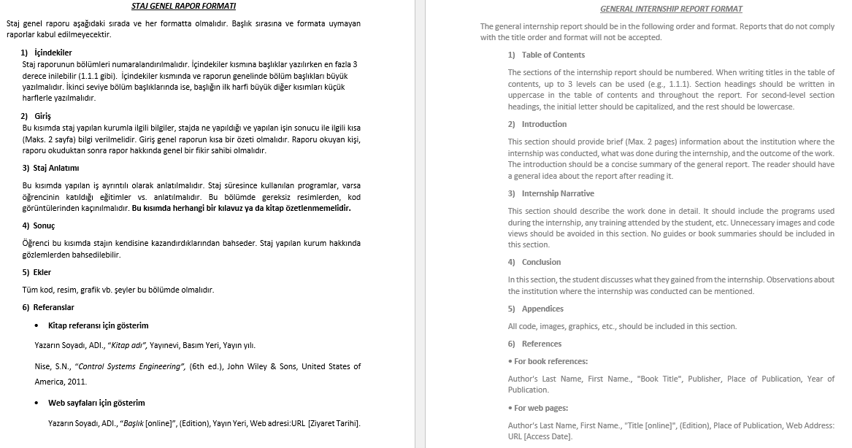
Post-Internship Process
After the internship, students fill out the General Report section of the Internship Report in digital format, with a minimum of 6 pages and a maximum of 16 pages, excluding Contents, Appendices and References sections.

Slide 25
Post-Internship Process
When filling out the General Report, attention should be paid to the following points: images or codes should be included in the appendices section, references should be made to these contents from within the report, and contents without references should not be included in the report.
At the same time, students should not provide a definition of the technologies they used longer than a small paragraph. The focus of the report should be on the work done with that technology, not what the technology is.

Slide 26
Post-Internship Process
For example, students who provide explanations spanning a whole page on what HTML, CSS, and JavaScript are may be asked to revise their notebooks, and if necessary, they may be considered unsuccessful.
Instead, a brief paragraph should be provided to explain these concepts, and the focus should be on how these technologies were utilized in the projects carried out during the internship process.

Slide 27
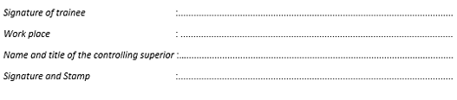
Post-Internship Process
Students stamp and sign the Internship Summary section of the Internship Report with their mentor, who has a suitable degree.
They also staple the pages of the General Report.

Slide 28
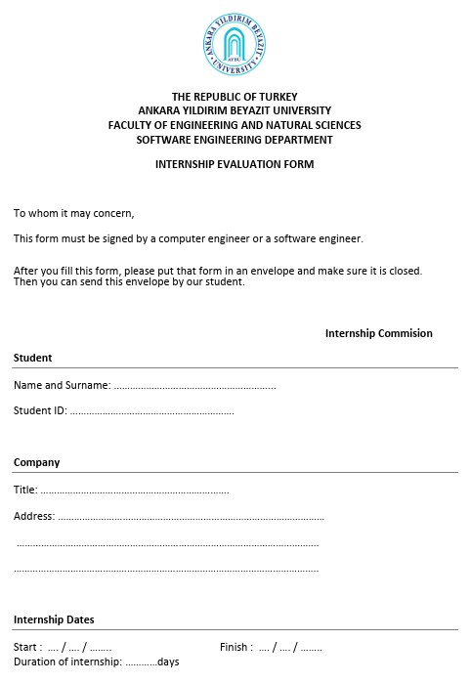

Post-Internship Process
Students submit the Internship Evaluation Form (Staj Sonuç Belgesi) to the Computer/Software Engineer responsible for them. The Computer/Software Engineer fills out and signs the document, and if available, puts it in an envelope without showing it to the student, seals the envelope, and hands it over to the student. (This document can be signed in Turkish)

Slide 29
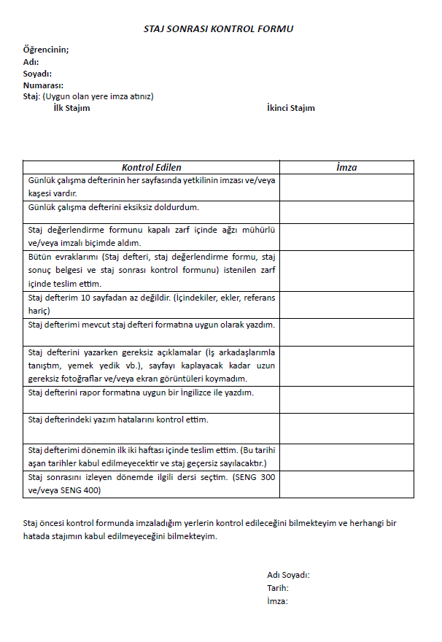

Post-Internship Process
Students bind their Internship Reports with spiral binding.
Students fill out the Post-Internship Control Form (Staj Sonrası Kontrol Formu).
Notes:
Tr: https://docs.google.com/document/d/1dSfadjiospbjWwCNO2JbmWToE3ngxlI0/view
En: https://docs.google.com/document/d/1RC-TS0mwlpc00_E0lYkOmlt-QK5poOFd/view

Slide 30

Post-Internship Process
The Internship Report bound with spiral binding, the envelope containing the Internship Evaluation Form (Staj Sonuç Belgesi) obtained from the company, and the Post-Internship Control Form (Staj Sonrası Kontrol Formu) are placed in a large envelope.

Slide 31



the Internship Report
the Internship Evaluation Form
(Staj Sonuç Belgesi)
the Post-Internship Control Form
(Staj Sonrası Kontrol Formu)
COMPANY NAME
STUDENT ID
NAME SURNAME
SENG300
SENG400
Voluntary Internship

Slide 32
Post-Internship Process
The envelope should be labeled with the Company Name, the Student ID, Name, Surname, and Internship (SENG300, SENG400, Voluntary Internship) Information, and it should be submitted to the Department Secretary within 2 weeks from the beginning of the Fall semester following the Summer term in which the internship was completed.
COMPANY NAME
STUDENT ID
NAME SURNAME
SENG300
SENG400
Voluntary Internship

Slide 33

Post-Internship Process
Students should add the course SENG300 Industrial Practice I to their course registration if it is their first internship period in the Fall semester following the internship period. If it is their second internship period, they should add the course SENG400 Industrial Practice II. If students have completed two internships, they can select both courses.

Slide 34

Evaluation

Slide 35
Evaluation
An assessment of the submitted files to the Internship Commission is conducted within the first 4 weeks.
Since the files are delivered from the Department Secretary to the Internship Commission, the evaluation takes place during the first 4 weeks of the Fall Semester.
Reports submitted after the beginning of the Fall Semester will not be considered for evaluation.

Slide 36
Evaluation
Students who are requested for revisions must complete their revisions within 2 weeks after the announcement of the results.
If there are no major changes in the content of the documents, re-signing of the correction documents may not be necessary. The decision of the internship commission is valid in this regard. Students have the right to revise their documents only once.
Once the internship grades are finalized after revisions, they are sent to advisors. Advisors enter the internship grades for students

Slide 37

Frequently Asked Questions

Slide 38
Frequently Asked Questions
If you couldn't do an internship in your second year, what should you do?
During the summer term of the third year, you can do 2 internships.
During the summer term of the third year, you can do 1 internship, and during the summer term of the fourth year, you can do another internship.
During the summer term of the fourth year, you can do 2 internships.
Can I do an internship during the intersession or within the semester?
You can only do an internship during the intersession or within the semester if you only have the internship course left and have completed all other courses. Otherwise, it is not possible.

Slide 39

Frequently Asked Questions
If you want to do an internship abroad, what should you do?
  Students who will do an internship abroad must submit a letter stating that they will cover their own expenses and obligations, including travel, accommodation, insurance costs related to their internship abroad, along with an invitation and acceptance letter from the internship location to the relevant assistants at least 1 month before the start date of the internship.
  Students who do internships abroad must also provide the relevant assistants with a document from the internship location indicating the scope, work, and duration of the internship, in addition to the required documents, upon their return to the country after completing the internship.

Slide 40

Contact

Slide 41

Contact
If you have any questions regarding the internship send a mail to sengaybuinternship@gmail.com;
  Please introduce yourself (Student ID, full name) in your message.
  When you send an email to the address above, you will be able to reach all assistants in the commission in a single email.
  Clearly state the subject of the email.
  For example: «Regarding Internship Inquiry» or «Staj Hakkında»

Slide 42

Question & Answer

Slide 43

Thank You for Your Attention

