Slide 1
IE300-IE400
Industrial Practice I-II
Res. Asst. Emine Nur Nacar

Slide 2
General Info
2 Internship! – IE300 and IE400 (each 20 working days)
Production-Service (OR Production-Production(not preferable)) (At least 1 Production/1st one)
3 Engineers OR 1 Industrial Engineer
You will find THE COMPANY BY YOURSELF
Also check: https://aybu.edu.tr/endustrimuh/tr/duyuru/20473/Staj-Hakk%C4%B1nda

Slide 3
BEFORE INTERNSHIP

Slide 4
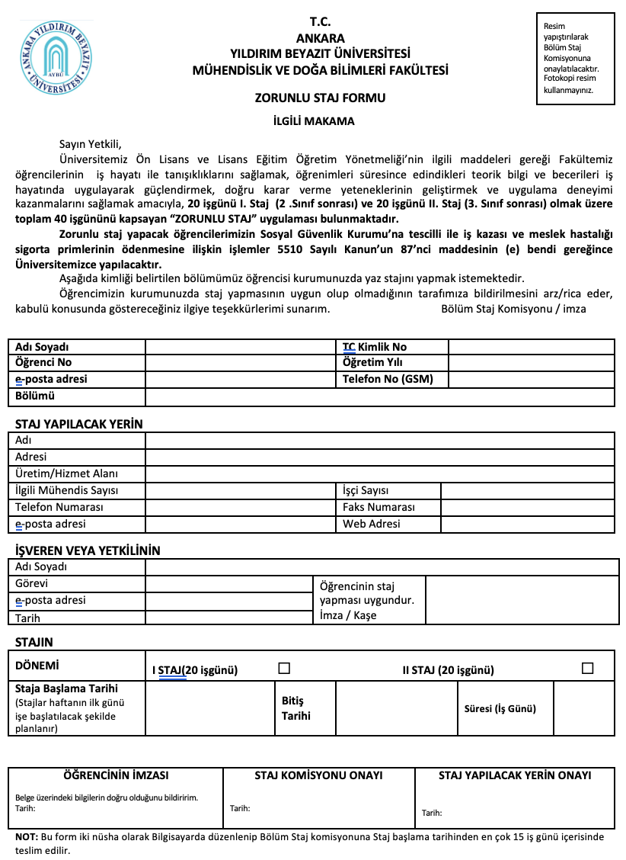
Before Internship
3 documents!!!
Document link: https://aybu.edu.tr/endustrimuh/tr/sayfa/2040/Staj-Formlar%C4%B1
1. “Zorunlu Staj Formu” (2 copies) (The company will sign and stamp it.)

Slide 5
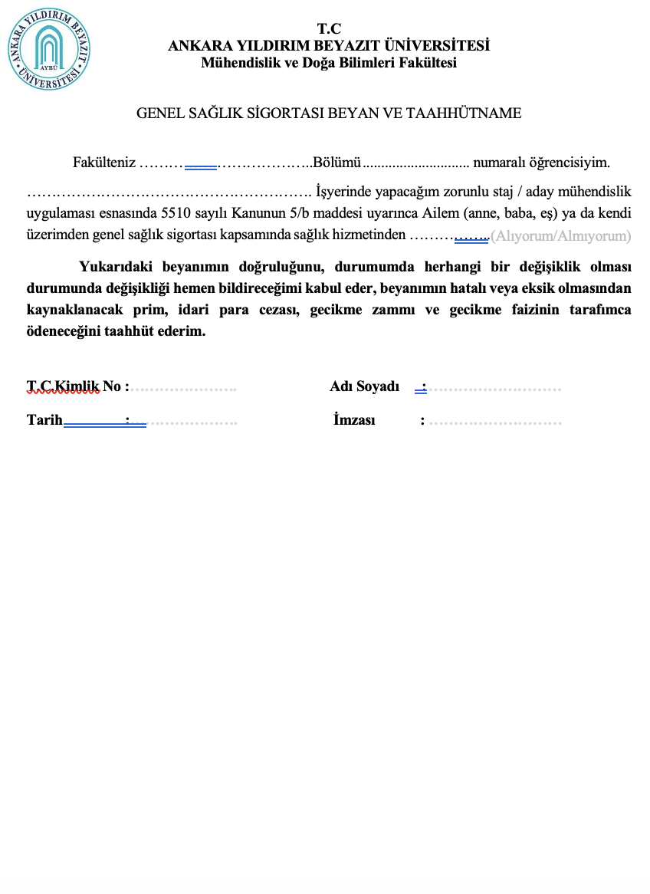
Before Internship (cont.)
2. “Genel Sağlık Sigortası Beyan ve Taahhütname”
Almıyorum – I/my family do not work at insured job.
Alıyorum - I/my family work at insured job.

Slide 6
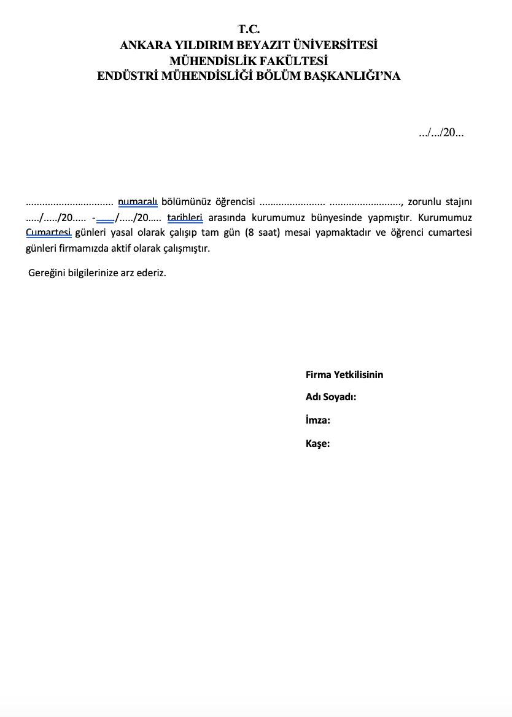
Before Internship (cont.)
3. “Cumartesi çalışma belgesi”
(not compulsory)
If you work on Saturday.

Slide 7
Before Internship (cont.)
Bring your documents before the academic calendar ends !
If you have to, you can bring it up to 3 weeks before the internship starts.
Internship documents will only be received on Mondays between 11.00-12.00.
Responsible from Internship: Res. Asst. Emine Nur Nacar, Res. Asst. Yağmur Arıöz
Do not use communication tools such as mail, WhatsApp, or phone calls!!! For your questions, come on the relevant day and time.

Slide 8
AFTER INTERNSHIP

Slide 9
After Internship
1.“Staj Degerlendirme Formu”
2. Internship questions (Production/Service)+Internship report

Slide 10
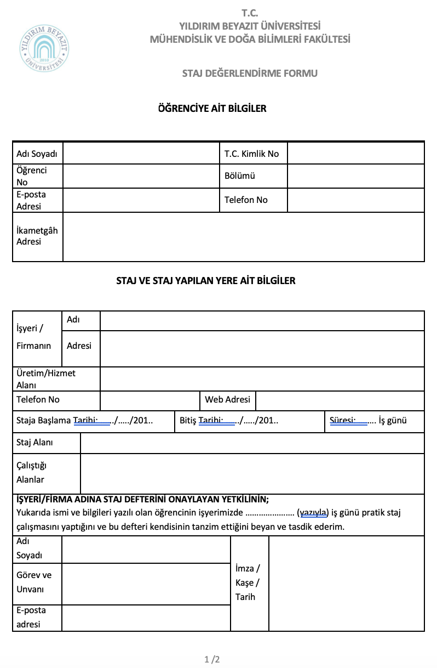
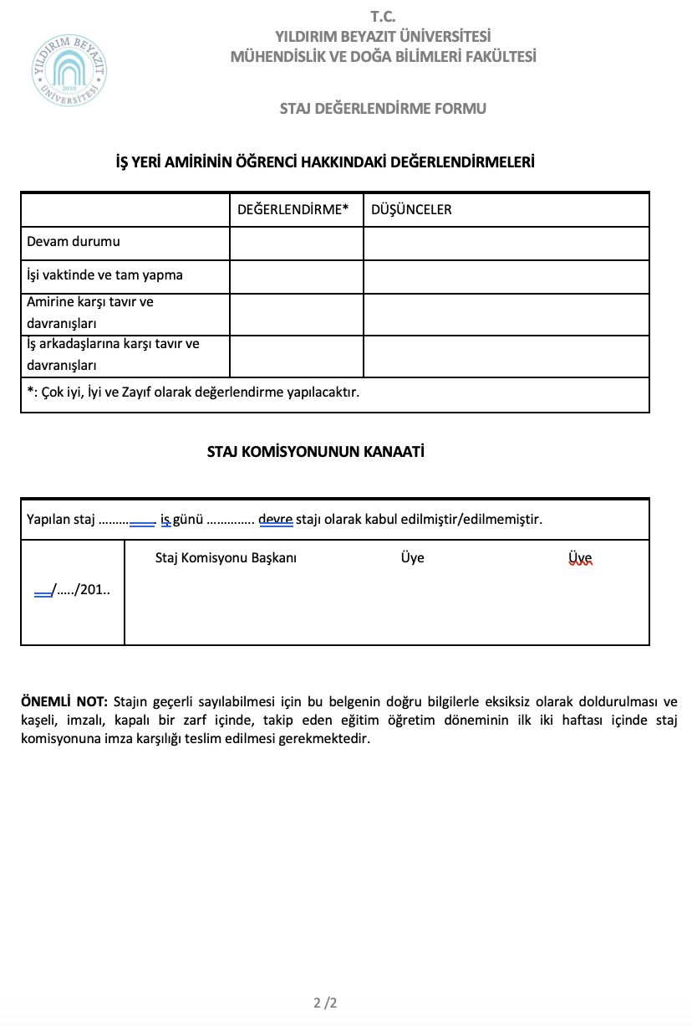
After Internship
(cont.)
1. Submit this document in a sealed envelope.

Slide 11
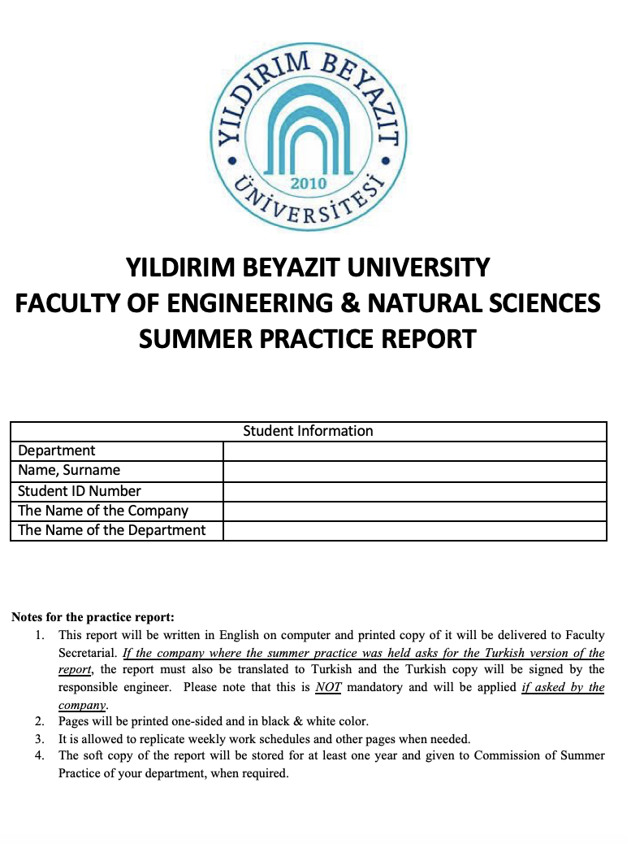
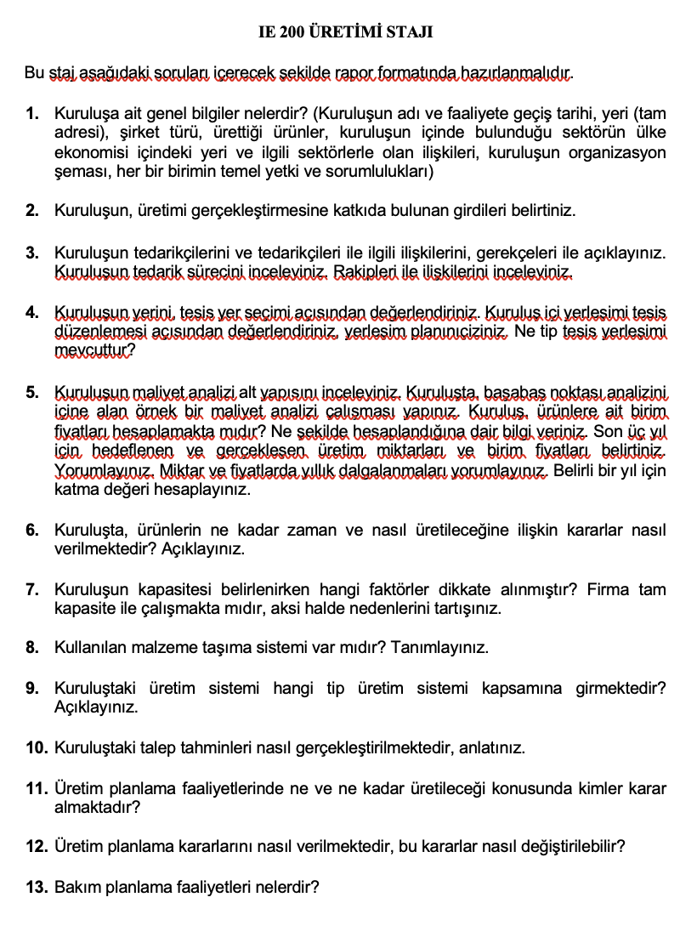
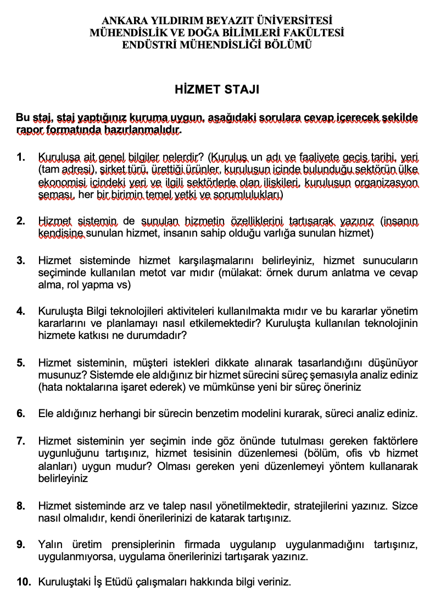
After Internship (cont.)
2. Internship questions (Production/Service)
+
Internship report
OR

Slide 12
After Internship (cont.)
“Staj Degerlendirme Formu”
It will be hand delivered to Res. Asst. Emine Nur Nacar or Res. Asst. Yağmur Arıöz in the first week of November.
2. Internship questions (Production/Service)
+
Internship report
Two documents will be prepared. It will be uploaded as a single pdf to the Drive link below in the first week of November.

