Slide 1
GRADUATİON WORK

Slide 2
The submission of works for all subfields (internship, article, voluntary community service) will be made to the office of the Department of Psychology during the final period of the fall semester. (The specific day and time range will be announced later). Before submitting the printed versions of their reports/articles, all students are required to send the final versions of their reports/articles to ybubitirmeprojesi@gmail.com.
The submission of the works will be against signature; if a friend will submit on your behalf, we will require that person to present a signed petition written by you stating that they will be submitting the work.
Those who have completed the graduation project course in the subfields of internship and voluntary community service must submit their reports, journals, performance evaluation, and attendance forms (these can be either separate or together) within an open yellow file envelope (with the opening unsealed) along with the Graduation Project Submission Document (Delivery Deed).
Those who have completed the graduation project course in the article writing subfield must submit their articles (two copies) within an open yellow file envelope (with the opening unsealed) along with the Graduation Project Submission Document (Delivery Deed), and the Article Writing Subfield Ethics and Signature Form.
The submission of works for all subfields (internship, article, voluntary community service) will be made to the office of the Department of Psychology during the final period of the fall semester. (The specific day and time range will be announced later). Before submitting the printed versions of their reports/articles, all students are required to send the final versions of their reports/articles to ybubitirmeprojesi@gmail.com.
The submission of the works will be against signature; if a friend will submit on your behalf, we will require that person to present a signed petition written by you stating that they will be submitting the work.
Those who have completed the graduation project course in the subfields of internship and voluntary community service must submit their reports, journals, performance evaluation, and attendance forms (these can be either separate or together) within an open yellow file envelope (with the opening unsealed) along with the Graduation Project Submission Document (Delivery Deed).
Those who have completed the graduation project course in the article writing subfield must submit their articles (two copies) within an open yellow file envelope (with the opening unsealed) along with the Graduation Project Submission Document (Delivery Deed), and the Article Writing Subfield Ethics and Signature Form.
The submission of works for all subfields (internship, article, voluntary community service) will be made to the office of the Department of Psychology during the final period of the fall semester. (The specific day and time range will be announced later). Before submitting the printed versions of their reports/articles, all students are required to send the final versions of their reports/articles to ybubitirmeprojesi@gmail.com.
The submission of the works will be against signature; if a friend will submit on your behalf, we will require that person to present a signed petition written by you stating that they will be submitting the work.
Those who have completed the graduation project course in the subfields of internship and voluntary community service must submit their reports, journals, performance evaluation, and attendance forms (these can be either separate or together) within an open yellow file envelope (with the opening unsealed) along with the Graduation Project Submission Document (Delivery Deed).
Those who have completed the graduation project course in the article writing subfield must submit their articles (two copies) within an open yellow file envelope (with the opening unsealed) along with the Graduation Project Submission Document (Delivery Deed), and the Article Writing Subfield Ethics and Signature Form.

Slide 3
General Principles
Students may work in groups of up to two people, provided they also obtain the approval of their advisors. However, it is mandatory for each student to write their article individually and to submit separate articles.
The responsibility for applying to the AYBÜ Social and Humanities Ethics Committee related to the study that the student will conduct and the follow-up of the process lies with the student.
At the end of the term, the student's grade will be determined taking into account the article assessment made by the advisor. Articles will be evaluated considering organization, clarity of language, writing quality, and sources used. Students whose articles are found to be insufficient or who are detected to have plagiarized will be considered unsuccessful.
Article Options
Review article
Empirical article
Project report

Slide 4
LITERATURE REVIEW
The following steps are to be undertaken for compiling studies in the relevant literature:
Determining a topic to compile studies from the relevant literature,
Conducting a national and international literature review in line with this topic,
Classifying the studies found within the scope of the literature review according to their findings,
Summarizing and writing the classified studies in a fluid and comprehensible manner,
Evaluating these studies in accordance with the students' own ideas,
Identifying the gaps in the literature and proposing new research topics.

Slide 5
EMPIRICAL ARTİCLE

Slide 6
INTRODUCTION
Introduce the research question.
Give examples from previous studies to highlight the place of these variables in the literature.
Explain why the expected relationship between the variables is hypothesized.
Provide examples from similar studies.
If there are no similar studies, provide examples from studies that include other variables that could be related to the variables in the study.
After discussing the relevant literature, the hypotheses of the study are clearly stated.
What kind of relationship is expected?
The direction of the relationship (+/-).

Slide 7
METHODS
Research Sample
How participants were reached
Students of YBÜ (Yıldırım Beyazıt University) Psychology Department
Women's Shelters affiliated with the Çankaya Municipality
Participants' age and gender distribution:
Percentage, mean, standard deviation
Scales:
Introduction of the scales used in the research
Reference to the article where the scale was first developed
Reference to the article adapting the scale
Validity, reliability
Introduction of the sub-dimensions
Example items
Measurement Methods:
Introduction of the tests, experiments, videos, interviews, etc., used as measurement methods in the research
If the method has been used before, mention should be made of previous studies
If a new method has been developed, how it was developed should be explained.

Slide 8
Data Collection
Clearly stating each step implemented during the data collection phase
How and where were the scales/experiments applied?
How many minutes does it take to fill out the scales / apply the experiment in total?"

Slide 9
Results
"Reporting descriptive statistics related to the variables
Reporting whether the tested hypotheses are supported
Reporting the results of the relevant statistical analyses
Ensuring that findings are easier to follow with tables and figures"

Slide 10
Discussion

Slide 11
Project Report
"Students must work on a project that they have written and presented themselves and which has been accepted by the relevant institution in their field,
They must conduct a literature review within the scope of the project,
They are required to report the knowledge and data obtained as a result of the project appropriately and discuss them within the context of the literature,
They must write the project report in accordance with the headings that should be included in an empirical article

Slide 12




How will I write my internship report?

Slide 13
The internship report is the document in which students will address the professional knowledge and experience they have acquired during their Undergraduate Internship, within the framework of the information learned in the undergraduate program."
Internship Report
=
Theoretical Knowledge + Experiences & Observations

Slide 14
Simple but an important part: Format
Students will prepare the internship report in the language of their education and will write the report in Word using 12 point (Times New Roman) font, double spacing, and standard (2.5 cm) margins. The expected length of the internship report is between 20-30 pages, excluding references and appendices.

Slide 15
Content
Executive Summary
Internship Institution
Purpose and Scope of the Internship
Evaluation of the Internship Experience within the Framework of the Information Learned in the Undergraduate Program
Assessment
References
Appendices

Slide 16
Executive Report
Involves a summary of internship report.
Should be between 750-1000 words
Should cover a summary of all subsections involved in your report.

Slide 17
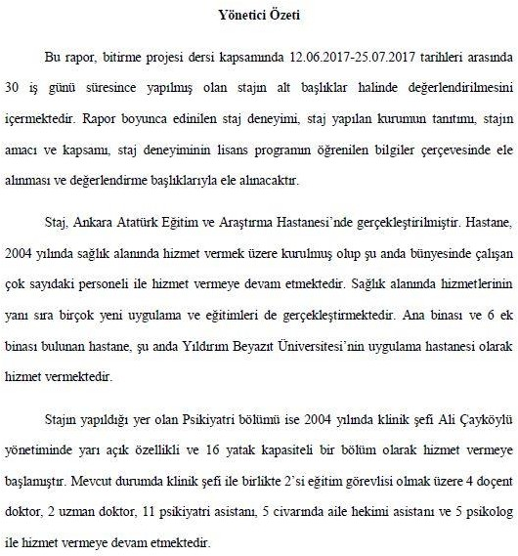

Slide 18
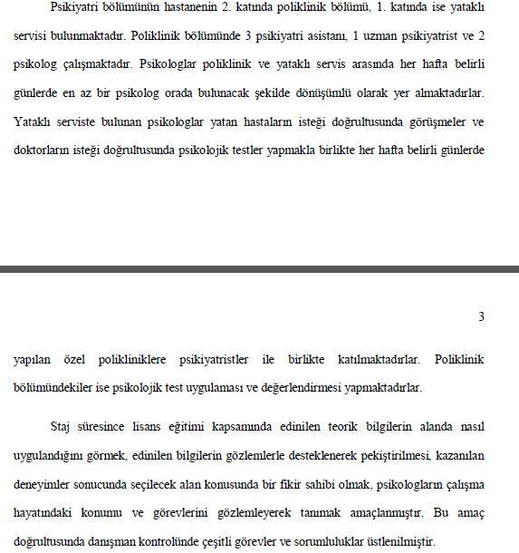

Slide 19


Slide 20
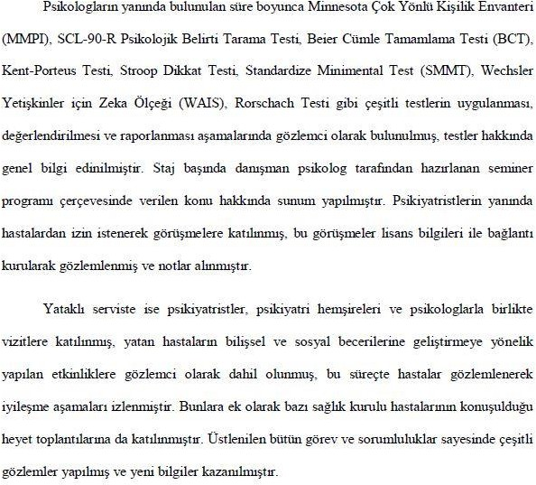

Slide 21
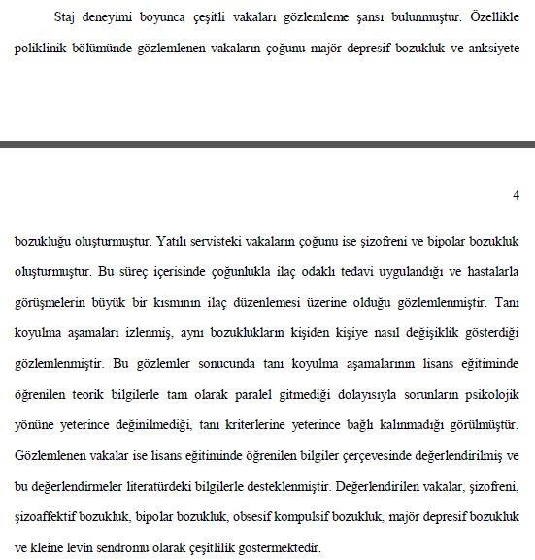

Slide 22
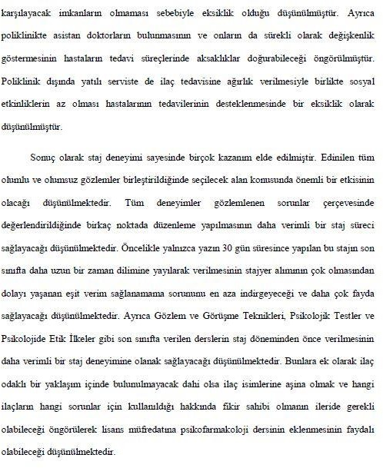

Slide 23
A closer look: Intership Institution
"the structure of the institution, the sector it serves and its position within that sector, its mission, size, and organizational chart" Maximum of 3 pages.
History, physical structure (e.g., number of beds), other individuals working at the institution and their roles, modus operandi...

Slide 24
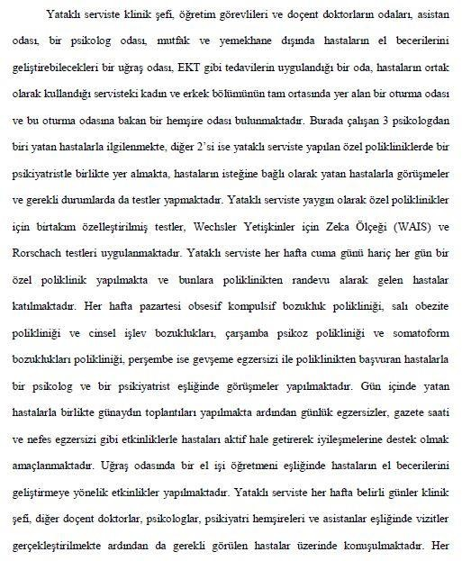

Slide 25
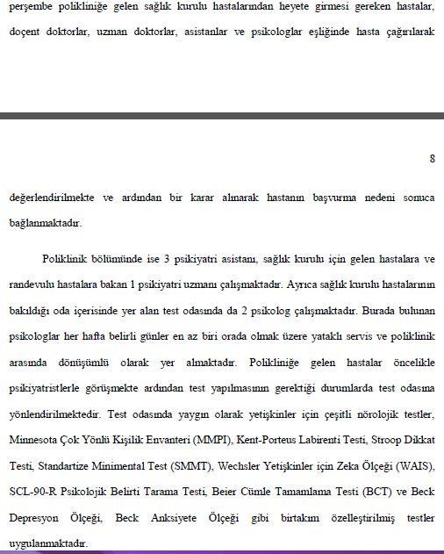

Slide 26
The Purpose and Scope of the Internship
"The duties and responsibilities undertaken by the student during the Undergraduate Internship" 2-4 pages.
The general objective of the undergraduate internship + your personal goal in doing this internship (were you able to achieve it?, if yes, how?, if no, why?, what is the impact of this on you and your future?) + the tasks given to you by your advisor at the institution.

Slide 27
Addressing the Internship Experience Within the Framework of the Information Learned in the Undergraduate Program.
The extent to which the knowledge gained in the undergraduate program, the theories and models learned, show parallels with the observations and experiences gained during the internship will be discussed, along with the observed differences and their reasons. Additionally, where appropriate, the observed role of cultural factors in the integration of internship and academic knowledge should also be written about, along with findings and suggestions on this subject. 10-15 pages.

Slide 28
Addressing the Internship Experience Within the Framework of the Information Learned in the Undergraduate Program.
"During the internship, I had the opportunity to observe many of the psychological disorders that we learned about in our classes... However, I noticed during my internship that not everything was as we learned in class. For example, although we were taught that a certain number of criteria were necessary for a person to receive a disorder diagnosis, I saw that doctors did not pay much attention to the number of criteria. If a person came with a critical symptom, a diagnosis could be made without much attention to the number of symptoms."

Slide 29
Addressing the Internship Experience Within the Framework of the Information Learned in the Undergraduate Program.
..In addition to these, I realized how disorders can manifest differently in different individuals. For instance, I observed the impact of clinical symptoms on clients' daily lives, along with their struggles.
For example, you may discuss the advantages or disadvantages that prior familiarity or lack thereof with the X test provided you."

Slide 30
Addressing the Internship Experience Within the Framework of the Information Learned in the Undergraduate Program.
The first case of depression I encountered was an atypical depression. Razali (2000) stated that if the symptoms are ambiguous and do not correspond to an organic disorder, or if the patient does not respond to the treatment that normally resolves the apparent disorder, atypical depression should be considered as a diagnosis. Moreover, he mentioned that these patients are unlikely to accept the relationship of their symptoms with depression and will instead attribute their symptoms to an organic illness they believe they have. However, the patient I saw was fully aware of everything. They knew their diagnosis and it wasn’t their first visit to the outpatient clinic…."

Slide 31
Addressing the Internship Experience Within the Framework of the Information Learned in the Undergraduate Program.
"...In the inpatient service, when patients with depression did not respond to medication, doctors decided to administer ECT. Although ECT is also applied to patients with bipolar disorder, I did not have the chance to observe this. However, according to the study by Sienaert et al. (2009), patients with bipolar depression tend to show a faster clinical improvement with ECT compared to patients with unipolar depression."

Slide 32
Addressing the Internship Experience Within the Framework of the Information Learned in the Undergraduate Program.
"When I encountered a patient with bipolar disorder in the women's service, I initially thought she was there because of a sleep disorder. She was fun and cheerful. However, I later learned that when she first arrived at the service, she had attacked another patient. I was very surprised when the doctors said that the patient was very aggressive and constantly swearing during that period."
This account touches on the complex nature of bipolar disorder, where a patient's mood can range from manic or hypomanic to depressive states, sometimes associated with other symptoms like irritability or aggression. It underscores the importance of comprehensive assessment and management in psychiatric care to address both the mental health condition and any comorbid issues, such as sleep disturbances, that may be present.

Slide 33
Addressing the Internship Experience Within the Framework of the Information Learned in the Undergraduate Program.
"The frequency of seeing patients with depression was high in the outpatient clinic, yet, in the inpatient service, patients with bipolar disorder were in the majority."
"Additionally, I observed that some patients with bipolar disorder could have hallucinations and delusions. For example, one patient believed she was pregnant and would give birth to Jesus."

Slide 34
Addressing the Internship Experience Within the Framework of the Information Learned in the Undergraduate Program.
The issue with the exaggeration of symptoms and the cognitive level suggests that CBT might be a good choice as a treatment method. In the therapy of these patients, methods that facilitate awareness of reality and recognition of inconsistencies using cognitive therapy strategies can be employed (Beck, 2008). Results from a study comparing the effectiveness of individual treatments (SSRI alone or CBT alone) with combined treatments (SSRI + CBT) show that although all treatments are effective, the combined treatment is superior to just CBT. However, the difference in effectiveness between SSRI treatment and the other two treatments is not very significant. (van Apeldoorn, van Hout, Mersch, Huisman, Slaap, Hale III, Visser, van Dyck, & van der Boer, 2008)."

Slide 35
Addressing the Internship Experience Within the Framework of the Information Learned in the Undergraduate Program.
"(Speaking of OCD) 'The most common compulsions encountered were cleaning and checking. In the hospital, I observed that the symptoms of most patients emerged after a traumatic event for them. When I saw a female patient who started incessantly asking questions about God, religion, Satan, and death after the loss of a relative whom she saw in good health just a week before, I wondered why she exhibited these symptoms while other patients did not. According to a study conducted with a Turkish sample (Yorulmaz, Gençöz, & Woody, 2009), being religious is a predisposing factor for OCD in this sample. This woman was also very religious and was someone who couldn't even bear the existence of people who didn't believe in God. However, organic factors may also be causing this predisposition. It has been revealed that the pituitary gland volume in OCD patients is much lower (Atmaca, et al., 2009).'"

Slide 36
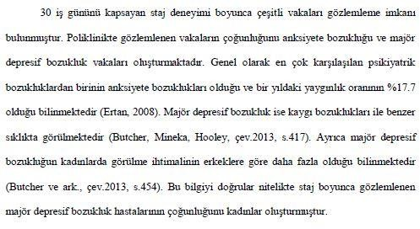

Slide 37
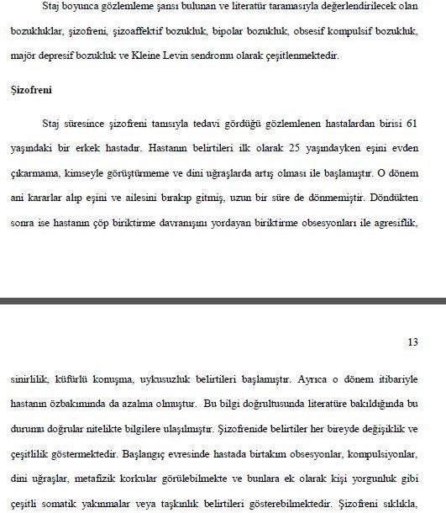

Slide 38


Slide 39
Evaluation
Critical Evaluation of the Internship.
Gains obtained from the internship experience, problems encountered, and suggestions for the internship and academic programs. 2-5 pages.

Slide 40
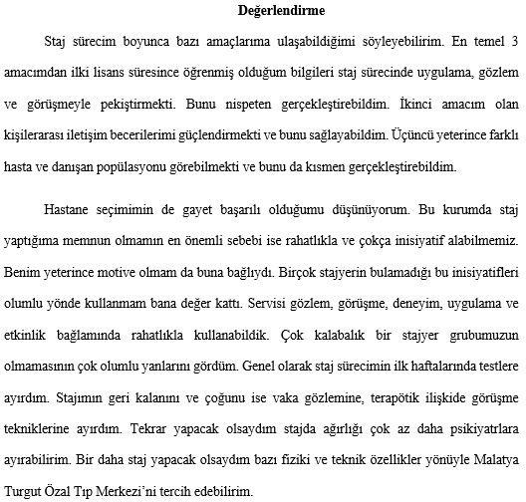

Slide 41
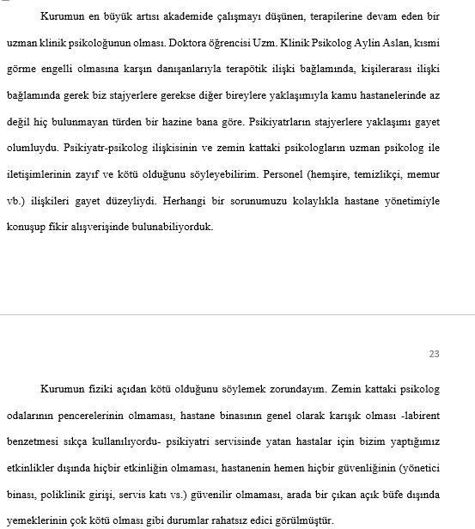

Slide 42
References
ll sources used in the report (including web pages and other internet-based sources) should be listed taking into account APA citation rules. In addition, all sources used within the text must be cited according to APA citation rules. If there are quotes and citations that do not comply with the citation rules, the student's report will be considered invalid, and the student will be considered to have failed the course."

Slide 43
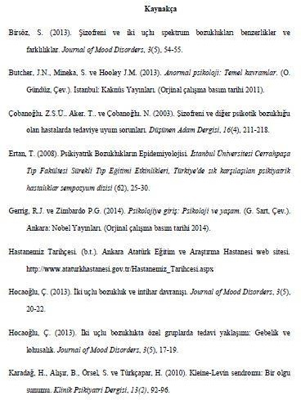

Slide 44
Supplementary
"Supporting materials mentioned in the report (organizational charts, tables, figures, etc.) should be presented in the Appendices section.
Internship diaries!"

Slide 45
"Include the contributions of the internship or volunteer community service you have done to yourself.
Discuss the difficulties and problems you encountered during this process.
If you were to do this internship/work again, what would you change?
Evaluate the impact of this internship/work in terms of shaping your education.
What contributions did it make to your personal development?
What recommendations might you have for this internship/work? You can give us feedback."

Slide 46



