Slide 1
Graduation project
2023
AYBÜ Psikoloji

Slide 2


Graduation Project: The Graduation Project is a study that psychology undergraduate students will complete within the scope of the relevant courses they will take in the final year of their undergraduate education, allowing them to apply the theoretical knowledge they have acquired throughout their undergraduate education through article writing, voluntary community service activities, and studies in one of the internship areas. The aim of the Graduation Project is to prepare students for the post-graduation period by gaining experience in how the theoretical knowledge they have acquired during their undergraduate education can be used in field applications and scientific research.

Slide 3
Areas for Graduation Projects:
Internship
Voluntary community service
Article writing

Slide 4
Internship
Undergraduate Internship: The Undergraduate Internship is a subfield that can be chosen by psychology department students who meet the conditions specified in the Graduation Project Regulation within the scope of the Graduation Project course. The Undergraduate Internship can be carried out in at least one and at most two institutions, covering internship activities for 30 working days. In internships conducted within the scope of the national internship program, 20 working days are also accepted.

Slide 5
INTERNSHİP
The aim of the undergraduate internship is to support and reinforce the knowledge students have gained in their undergraduate program with field experience. In line with this fundamental purpose, the undergraduate internship aims to enable students to observe, gain experience, become aware of, and raise their awareness in different application and research areas of psychology. The goal is to enrich their perspectives on culture-specific applications of the theoretical knowledge they have acquired within the framework of the undergraduate program, and thus to increase their motivation for higher-level work in academic and applied fields. It aims to contribute to the development of positive work habits and work discipline.

Slide 6

Places where internships can be done:
Students can complete their undergraduate internships in a total of 30 working days at any official or private institutions where psychologists work and psychological services are provided. For example:
Kindergartens, daycares, and special education centers
Nursing homes
Orphanages
Hospitals and other health units
Rehabilitation centers
Human resources, personnel, training, and R&D departments or divisions of public and private sector institutions
Research centers or companies
Advertising companies
Field studies or projects related to behavioral sciences
Research laboratories or centers for basic sciences such as biology, pharmacology, and physiology
Foundations working in the field of mental health
Institutions affiliated with the Ministry of Justice (Family courts, Juvenile courts, Juvenile detention centers, prisons, etc.)

Slide 7
Internship oppurtunities
Individual Internship Opportunities
Internships conducted within the scope of the Presidential National Internship Program

Slide 8
Processes Required for Individual Internships:
Students establish contact with the institution where they will do their undergraduate internships themselves and obtain approval from the institution by conducting the necessary interviews. In some special cases, the institution where the internship will be carried out may be suggested to the student by the department or the Course Coordinator. To start an internship, undergraduate students need to follow the steps below:
Step 1: Attend the Graduation Project Training provided by the department,
Step 2: At the end of the Graduation Project Training, read the TPD Ethical Regulation.
Step 3: Find a suitable institution (The compulsory internship petition can also be used at this stage)
Step 4: Obtain the approval of the coordinator of the potential internship institution and, if necessary, the Course Coordinator,
Step 5: Send the Internship Protocol, which expresses the department's expectations from the internship, and the Compulsory Internship Form to the institution where the internship will be carried out, and have the institution sign these documents,
Step 6: Submit the approved Internship Protocol and Compulsory Internship Form to the department's internship coordinator. Send a copy of the approved documents to the institution where the internship will be carried out.
Step 7: By the date announced by the department, (1) Compulsory Internship Form, (2) Internship Protocol Form, (3) Internship Code of Conduct, (4) Insurance Declaration Form, (5) Eligibility Certificate (6) Ethical Approval Form, and
(7) Graduation Project Application Form (Subfield selection form) will be filled out and submitted to the department. (For internships conducted within the scope of internship mobilization, a document confirming acceptance should also be provided)
Step 8: After the internship, the (8) Intern Performance Evaluation Form and (9) Internship Continuation Form will
be filled out by the institution where the internship was carried out and submitted to the department in a sealed envelope in the following fall semester.
Step 9: The knowledge and experience gained during the internship will be converted into a Graduation Report in an academic writing format. The "Internship Diary" will also be included in the internship report.

Slide 9
Step 1: Graduation Project Training
It is the training where the scope and details of the graduation project are explained by the department.
It is held during the spring semester of each academic year.

Slide 10

Step 2: TPD Ethical Regulations
You can access the document through this link: (https://drive.google.com/drive/u/1/folders/1m6Ok2i1QFq-SLvt4f17PUh9Uh3k2UgN4) It is very important to know the ethical issues that should be considered before starting the internship. Therefore, the relevant document must be read before starting the internship.

Slide 11
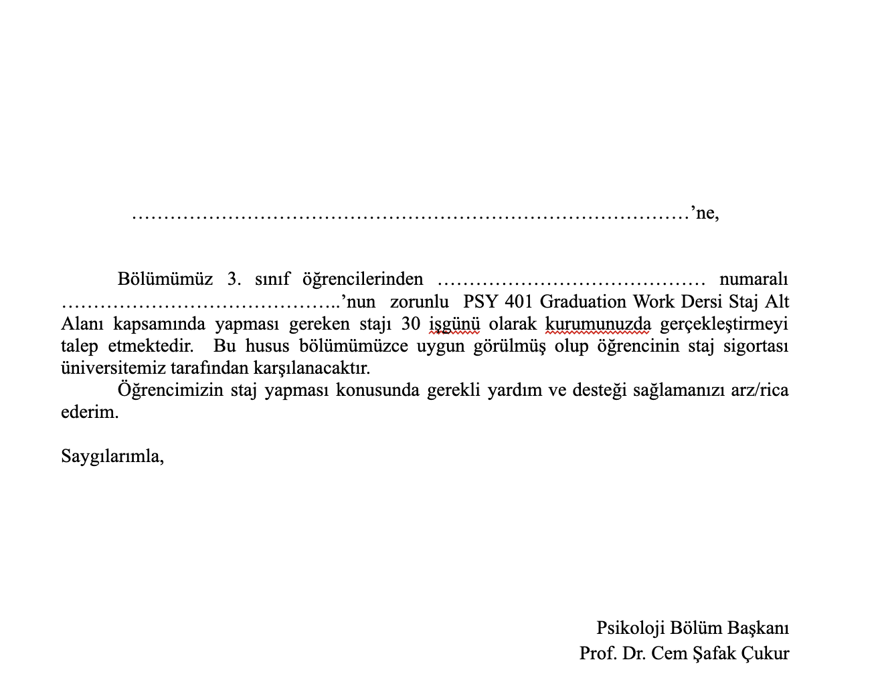
STEP 3: FİNDİNG THE İNSTUTİON
inding an institution for the internship is entirely the student's responsibility. Internships can be done in institutions where at least one psychologist is present. Internships can be done within the scope of the national internship mobilization. You can check the following link for applications: (https://kariyerkapisi.cbiko.gov.tr/ulusalstajprogrami) The student will carry out the internship application and finding a suitable institution. During this process, they may choose to use the "Compulsory Internship Petition Form" or not. They can initially agree with the institution verbally. The Compulsory Internship Petition Form is not a mandatory form to be submitted to the institution. If the institution requests it, you can get it signed by the department head as 1 copy to give to the institution. This form will not be submitted to the department later. You can access the relevant form via this link: (https://docs.google.com/document/d/1Q-WqQiIydXV3FjjMmG91ZNVe-ptrh1P7/edit)
Note: There is no need for this document within the scope of the national internship mobilization because applications are made through the system.

Slide 12
Mandatory Internship Petition: Questions and Answers
How many copies of this document am I allowed to have signed?
You can have one for each institution you are applying to. One copy per institution is sufficient.
The institution requires an official letter from the department for internship application. Is this document sufficient?
Yes, this document will be sufficient as an official document. If the relevant institution does not accept this document and requests another type of official letter, no additional letter will be prepared. This is the only official form for application.
Should this document be filled out on the computer or by hand?
All documents to be brought to (or sent to) the department must be filled out on the computer. However, since you will not submit this document to the department, whether you fill it out by hand or on the computer will not be a problem for us.
How can I apply within the scope of the National Internship Mobilization (Career Gate)?
Our department is not involved in applications made within the scope of the internship mobilization. You can ask all your related questions to the relevant unit.
Psychologists can usually work at the institution, but there is currently no psychologist. Can I do an internship at this institution?
There must be a psychologist present at the institution during the internship. However, in compulsory situations, the presence of a psychiatrist, a guidance teacher (RPD graduate specialists), and a social worker will be sufficient.

Slide 13
Step 4: Obtaining the approval of the coordinator of the potential internship institution
Students who are notified verbally or in writing that their application has been accepted can proceed to the next stage for the necessary documents.
No specific document is required at this stage. If there are any doubts regarding the institution where the internship is to be conducted (such as no psychologist working at the institution), this stage is when students can consult with internship coordinators and decide whether or not to do an internship at the relevant institution.

Slide 14
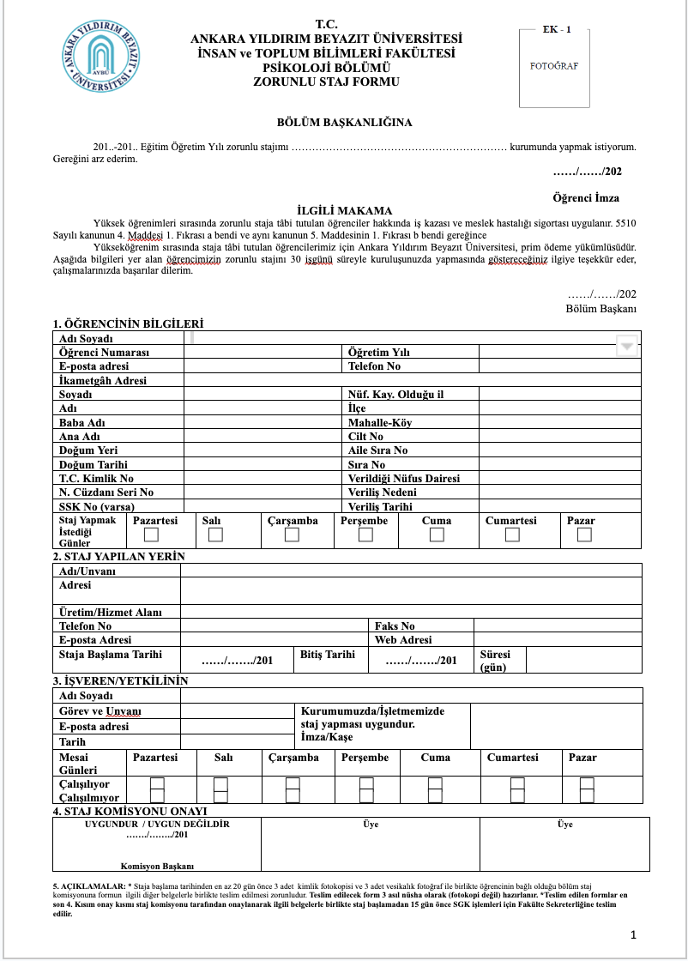
Step: Submission of the Internship Protocol and Compulsory Internship Form to the institution where the internship will be conducted and the institution's signing of these documents.
After the place where the internship will be conducted has been determined, there are two documents that the institution and department must sign. These are: Compulsory Internship Form (https://docs.google.com/document/d/1QdfuQdzy01oI0X3ILuj9pHtXDSddmxS2/edit) Internship Protocol (https://docs.google.com/document/d/1IWvXkO-tmlD2lrrM_JGuXCVG42ZsofIr/edit) (1) Three copies of the compulsory internship form should be prepared. All the information on this form should be filled out on the computer. Once this document is filled out on the computer, it should first be filled out and stamped by the institution where the internship will be conducted, and then signed. Afterwards, it should be brought to the department and signed there as well. After the department signs it, one copy will be submitted to the institution where the internship will be conducted, and the other two copies will be kept by the student to be collected later. The section in the Compulsory Internship Form regarding the number of days should be filled out to complete 30 working days. Calculation should be made after deducting holidays. Documents that are not filled out correctly regarding the number of working days will not be accepted.

Slide 15
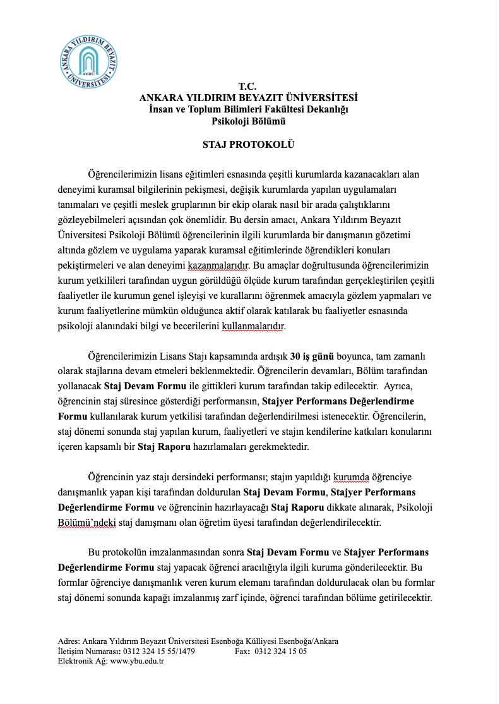
Step: Submission of the Internship Protocol and Compulsory Internship Form to the institution where the internship will be conducted and the institution's signing of these documents.
(2) The Internship Protocol must also be filled out on the computer, like the Compulsory Internship Form, and signed by the institution first. Two copies of this document will be prepared. It will be filled out and stamped by the institution where the internship will be conducted first, and then signed by the department. After the signatures are completed, one copy will be submitted to the relevant institution, and the other copy will be kept by the student to be collected later. If the institution does not want a computer printout of the Internship Protocol document, it can be filled out by hand.

Slide 16
Mandatory Internship Form and Questions Related to Internship Protocol
  Would there be a problem if these documents are not filled out on the computer?
  The mandatory internship form must be filled out on the computer. However, Part 3 of the mandatory internship form (Employer/Authorized person's information) can be filled out by hand in some cases. Nevertheless, the day part in this section should also be filled out using a computer. This is mandatory. The internship protocol can be filled out by hand in some cases.
  Should I include holidays and national holidays when calculating the days?
  Since internships cannot be carried out during holidays and national holidays, these days will definitely not be included. The days will be calculated after the holidays are excluded.
  Would it be a problem if I accidentally write the dates for 29 days instead of 30 days?
  If there is a mistake in the day calculation, the document needs to be reissued because insurance procedures cannot be carried out. Therefore, it is crucial to be very careful. Should I fill out these documents for internships carried out within the scope of the national internship mobilization? These documents should be filled out for internships carried out within the scope of national internship mobilization. However, if institutions insist on not filling out these documents within the scope of national internship mobilization, they may not fill out the mandatory internship form. The internship protocol must be filled out.
  Can I bring these documents after the internship instead of the date announced before the internship?
  No, the relevant documents should only be submitted on the specified date before the internship. The institution wants to sign the mandatory internship form and internship protocol after the department. What can we do in this situation? In compulsory situations, these documents can first be signed by the department and then by the institution. When can I start my internship? Internships will start after the spring semester ends. This year, they will be held between 03.07.2023 and 20.09.2023. No internships will be carried out outside of these dates.

Slide 17
Step 6: Submission of the Approved Internship Protocol and Mandatory Internship Form to the department's internship coordinator.
This step has been explained in the previous step.
Questions and Answers: I will be doing an internship during the online period and may have trouble bringing the documents since I am not in Ankara. What should I do in this situation?
Since a wet signature is required, even if you live outside of Ankara, it would be more appropriate for you to bring the documents and have them signed. If you cannot come yourself, you can ask a relative in Ankara to bring the documents after you ship the documents to them. If this is not possible either, only in urgent cases (by informing the internship coordinator) the procedures can be handled by scanning the documents. However, in this case, the institution you have applied for must have taken care of the relevant documents.

Slide 18
  For the 2022-2023 academic year, all students must submit the listed documents below to the department by May 22, 2023. Documents will not be accepted before or after this date. Important: The specified dates are valid for individual internship procedures. For internships to be carried out within the scope of the national internship mobilization, those who have confirmed internship procedures will also submit their documents on this date. For internships earned later than this date within the scope of national internship mobilization, the relevant documents must be submitted to the department two weeks before the internship starts. Mandatory Internship Form: 2 Copies (https://docs.google.com/document/d/1QdfuQdzy01oI0X3ILuj9pHtXDSddmxS2/edit ) Internship Protocol: 1 Copy (https://docs.google.com/document/d/1IWvXkO-tmlD2lrrM_JGuXCVG42ZsofIr/edit ) Internship Code of Conduct: 1 Copy (https://docs.google.com/document/d/1eOWDw6k72iSOA-cyv3X7zJwlEQqBtdSn/edit#heading=h.gjdgxs ) Insurance Declaration Form: 3 Copies (https://docs.google.com/document/d/1IlBuwIv_BFFJMEfzD52PYQkZg3K2MTeR/edit ) Entitlement Document: 1 Copy. This document will be obtained from E-Devlet (e-Government). Ethics Approval Form: 1 Copy (https://docs.google.com/document/d/1BjgTSyN7z3tLYkY9z6SU85lZlEHKKLem/edit ) Graduation Project Application Form: 1 Copy (https://docs.google.com/document/d/1hR4V9sNbZaR8pwd3wzDcHHoYvbcvwkAI/edit )
  For internships conducted within the scope of National Internship Mobilization, a document proving acceptance from the relevant institution (acceptance email, screenshot, etc.) must be provided. Note: For insurance to be made in internships carried out within the scope of National Internship Mobilization, the institution where the internship is carried out must write and report an official letter stating that you have been accepted to the University. This is the responsibility of the relevant institution. In this regard, you can first communicate with the institution to ensure the letter is sent. If the institution creates a problem on this issue, please contact the internship coordinators.

Slide 19
Questions and Answers Related to Submitting Documents:
I have already prepared my documents. Can I submit them before the specified date?
No, all students will submit their documents on the same day.
I couldn't find a place to do an internship by the specified date. There was no place within the scope of the national internship mobilization, but I am still waiting. What should I do?
If you cannot find an institution where you can do an internship by the specified dates, you can choose to wait for an internship opportunity within the scope of the national internship mobilization, but you cannot start an internship individually at an institution outside the mobilization. The flexibility of the dates is only applicable to the internship mobilization. Therefore, if you cannot find an internship opportunity, you can choose to write an article instead.
I can't find the entitlement document in the department's drive folder. Where can I find it?
You can only get the entitlement document from e-Government (e-Devlet). All other documents are available in the drive folder.

Slide 20
Step 8: After the internship, the (8) Intern Performance Evaluation Form and (9) Internship Continuation Form must be filled out by the institution where the internship was conducted and submitted to the department in a sealed envelope during the following fall semester.
There are two documents that need to be submitted after the internship. These are: Intern Performance Evaluation Form (https://docs.google.com/document/d/1NEJePZzET9KZm3JEKks8ez_dEJ3wXaBr/edit ) Internship Continuation Form (https://docs.google.com/document/d/1NILcyODqsvP6IyzJ6ghbZE_p6b95za_e/edit ) Both of the documents above will be submitted along with the "Internship Report" during the fall semester of the following year.

Slide 21
DURİNG İNTERNSHİP
There are two documents that need to be submitted after the internship. These are: Intern Performance Evaluation Form (https://docs.google.com/document/d/1NEJePZzET9KZm3JEKks8ez_dEJ3wXaBr/edit ) Internship Continuation Form (https://docs.google.com/document/d/1NILcyODqsvP6IyzJ6ghbZE_p6b95za_e/edit ) Both of the documents above will be submitted along with the "Internship Report" during the fall semester of the following year.

Slide 22
General Questions about the Internship Process
I found an internship individually and started my procedures. But later, I received an offer from an institution within the scope of the National Internship Mobilization. Can I accept this offer? If the offer received does not conflict with the internship to be done already, both internship opportunities can be evaluated. However, in this case, no days should overlap. In case the days overlap, a choice should be made and only one institution should be continued. Once the internship has started, it cannot be abandoned and switched to another institution. If an institution is to be canceled before starting the internship, it must be reported to the department with a petition within two weeks at the latest.
Can I cancel my internship? The internship can be canceled if it is reported to the department chairmanship with a petition at least two weeks before starting the internship.
Can I send my documents by cargo? Document delivery by cargo is acceptable, but documents cannot be sent to you by cargo. In this regard, it would be better to get help from a relative.
Where can I access all the documents? You can access all the information from the graduation project page on the department's website. You can also access all documents from the following link: (https://drive.google.com/drive/u/1/folders/19A-rglFuqh2D-gMwmsY_kg5Fcxnaa_rn )
Should I write the internship diary in English? You can write the internship diary in Turkish or English. However, the internship report will be written in English.
Note: For the insurance to be made in internships within the scope of the National Internship Mobilization, the institution where the internship is done must write and inform the University with an official letter stating that you have been accepted. This is the responsibility of the relevant institution. In this regard, you can first contact the institution and ensure that the letter is sent. If the institution causes problems in this regard, please contact the internship coordinators.

Slide 23
General Questions About the Internship Process
The institution I want to intern at requires a document called "Internship Agreement". Where can I access this document? Our faculty does not have an internship agreement, and our faculty does not sign such agreements within this scope. However, if this document is required compulsorily, you can request a sample internship agreement from the institution and adapt it to our department. After the internship coordinators review the contents of the document, the department can sign the document if deemed appropriate.
I am interning at an institution (e.g., Ministry of Justice) and I have done my internship in two different units. In which unit should I get my documents signed after the internship? You can have your documents signed in the unit where you spent more days. If you have spent the same number of days in each unit, the signature of any unit will be sufficient.
I am asked to do only 20 days of internship within the scope of National Internship Mobilization. Is it enough? Yes, it will be sufficient within the scope of the internship mobilization, but for individual internships, a total of 30 days must be completed.
I was going to do a 30-day internship, but I got sick for a few days and couldn't attend. Will there be a problem? You need to get a report for your illnesses and inform our dean's office with a petition. You should send it to the faculty, that is, the dean's office, not the department.
The institution requires an SSI (Social Security Institution) entry document before starting the internship. Where can I obtain this document? This document will be sent to your email by the faculty the week before you start your internship. If you haven't received this document, you should contact the internship coordinators and report your situation at least three working days before starting the internship. Otherwise, your internship processes may be delayed.
Note: For insurances to be made within the scope of internships carried out within the National Internship Mobilization, the institution where the internship is held must send an official letter to the University stating that you have been accepted. This is the responsibility of the relevant institution. First, you can contact the institution and ensure that the letter is sent. If the institution causes problems in this regard, contact the internship coordinators.

Slide 24
Voluntary Community Service
Voluntary Community Service Work is a subfield that can be chosen by psychology department students who meet the conditions specified in the Graduation Project Regulation within the scope of the Graduation Project course. Voluntary Community Service Work can be carried out in at least one and at most two organizations and covers activities for 30 working days.
The goal of Voluntary Community Service Work is for students to make observations about the problems of the society they live in, gain awareness, and fulfill their responsibilities to society through teamwork and taking individual initiative. In this context, it covers practical and theoretical knowledge in creating social responsibility projects, project writing, implementation, getting to know and working with non-governmental organizations, and reporting projects. Voluntary Community Service Work equips students with the skills to better understand the society they live in; gain awareness about the problems faced by different segments of society; use the knowledge gained in the undergraduate program to solve these problems; conduct project work with different expertise areas; carry out voluntary work; and work within a team.

Slide 25
Voluntary Community Service
Students establish contact with the institution where they will perform voluntary community service themselves and obtain approval from the institution after conducting the necessary negotiations. In some special cases, the institution where the community service will be performed can be suggested to the student by the department or the advisor. To start voluntary community service applications, undergraduate students need to do the following:
Complete the Graduation Project Training provided by the department,
At the end of the Graduation Project Training, read and sign the Turkish Psychologists Association's Ethical Regulations and submit them to the relevant coordinator,
Find a suitable institution and obtain its approval for conducting the work there,
Obtain a suitability approval for the institution where the community service application will be conducted,
Submit the Voluntary Community Service Work Protocol, which expresses the expectations of the department from the study, to the institution where the study will be conducted, and have it signed by the relevant institution,
Deliver the approved Voluntary Community Service Work Protocol to the department's community service applications coordinator,
Send a copy of the approved protocol to the institution where the study will be conducted, and keep one copy in the department,
After downloading the Continuation Form and Performance Evaluation Form from the department's website, deliver them in a sealed envelope to the person in charge of the institution where the project will be conducted.

Slide 26
Voluntary Community Service
During the community service applications of psychology students, they are expected to:
Keep a handwritten Work Notebook/Diary, summarizing their observations and activities carried out within the scope of the study,
Work within the framework specified in the Graduation Project Training,
Avoid behaviors that violate the Turkish Psychologists Association's Ethical Regulations (the projects of students found to have violated the Ethical Regulations during the project will be considered invalid),
Be present at the institution where they are conducting their work within the specified timeframes,
Make an effort to ensure that the qualitative and quantitative aspects of their responsibilities meet or exceed the expected standards,
Be aware that they represent our University and Department in the institution where they are conducting their work, and
Work on the Study Report they will prepare at the end of the study.

Slide 27
Voluntary Community Service
Students who complete the Volunteer Community Service Activities will:
Obtain a written document from the institution where they conducted their work, indicating the completion of their projects, the Attendance Form filled out by the institution's authority, and the Performance Evaluation Form filled out by the institution's authority in a sealed envelope, and submit these to the relevant coordinators.
Submit their work reports (see Article 10), diaries, and the Student Work Evaluation Form filled out by themselves, all together in a folder, to the relevant coordinators.
You can access the documents related to Volunteer Community Service through this link: (https://drive.google.com/drive/u/1/folders/1v1gQv1zKH5gSnPF5fvmDRHWIIUQSsBM1)

Slide 28
3.Article writing
Article writing is a sub-field that can be chosen by psychology department students who meet the conditions specified in the Graduation Project Regulation, as part of the Graduation Project course. Students who choose this sub-field will fulfill the responsibilities of one of the options: empirical article, review article or project report. The aim is for students to use the knowledge they have gained in their undergraduate program in academic development and gain experience in writing articles with an academic and scientific language in the language they have received education in and in which they have sufficient knowledge accumulation in one of the research areas of psychology. Therefore, the main purpose of article writing is to provide students with experience in article writing.

Slide 29
3. Article writing
Students can choose one of the options for empirical article, review article or project report in the scope of article writing. Students who choose the article writing subfield in the scope of the Graduation Project Course will also submit the advisor assignment form with the subfield selection form. In this regard, they will choose the faculty member they want to work with and obtain their approval. Students who choose the article writing subfield can work in groups of up to two with the approval of their advisors. However, each student must write their article individually and submit separate articles. It is expected that students will follow the rules specified in the American Psychological Association (APA) 7th Edition and specific rules related to the type of article they choose when writing their articles. Students will prepare their articles in the language they received education, and write them in Word program using 12-point (Times New Roman), double-spaced, and standard (2.5 cm) margins. The expected length of the article is between 20-30 pages, excluding references and attachments.

Slide 30
Documents to be Submitted by Article Writers
People who will write articles must submit the following documents on May 22, 2023: Ethical approval form: 1 copy (https://docs.google.com/document/d/1BjgTSyN7z3tLYkY9z6SU85lZlEHKKLem/edit) Graduation project application form: 1 copy (https://docs.google.com/document/d/1hR4V9sNbZaR8pwd3wzDcHHoYvbcvwkAI/edit) Advisor appointment form: 1 copy (https://docs.google.com/document/d/1FiYS3sMBLOIZfgdRv1WZR7c9M80JF2S7/edit)
The written articles will be submitted in the fall semester of the next academic year. Training for article writing will be provided at the beginning of the fall semester. Documents to be submitted when submitting the article in the fall semester: Plagiarism statement: 2 copies (https://docs.google.com/document/d/1WAsVgmhYyF2Cbu0Cc_mBbQqAP0x_kM3_/edit) Article signature form: 2 copies (https://docs.google.com/document/d/1b9e7dC0eU1L6Wcg7LhnMs-b4x14BRKdV/edit) If a research article is written, the approval form obtained from the university's ethics committee should also be submitted.

Slide 31
Staj koordinatörleri
Arş. Gör. Sena Erdoğan: senaerdogan97@gmail.com
Arş. Gör. Ahmet Temel: ahmettemel41@gmail.com
Arş. Gör. Hasan Duymuş: hasanduymus9@gmail.com

